Slide 1
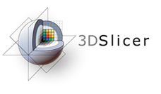



Diffusion MRI Analysis
Sonia Pujol, Ph.D.
Surgical Planning Laboratory
Harvard University

Slide 2
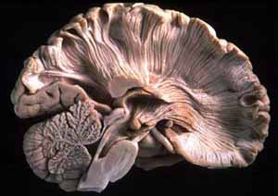
Brain Anatomy
White matter ~45% of the brain
Myelinated nerve fibers
(~ 10 μm axon diameter)

Slide 3
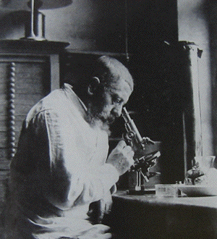
White Matter Exploration
Jules Joseph Dejerine (Anatomie des centres nerveux (Paris, 1890-1901): Atlas of Neuroanatomy based on myelin stained preparation

Slide 4
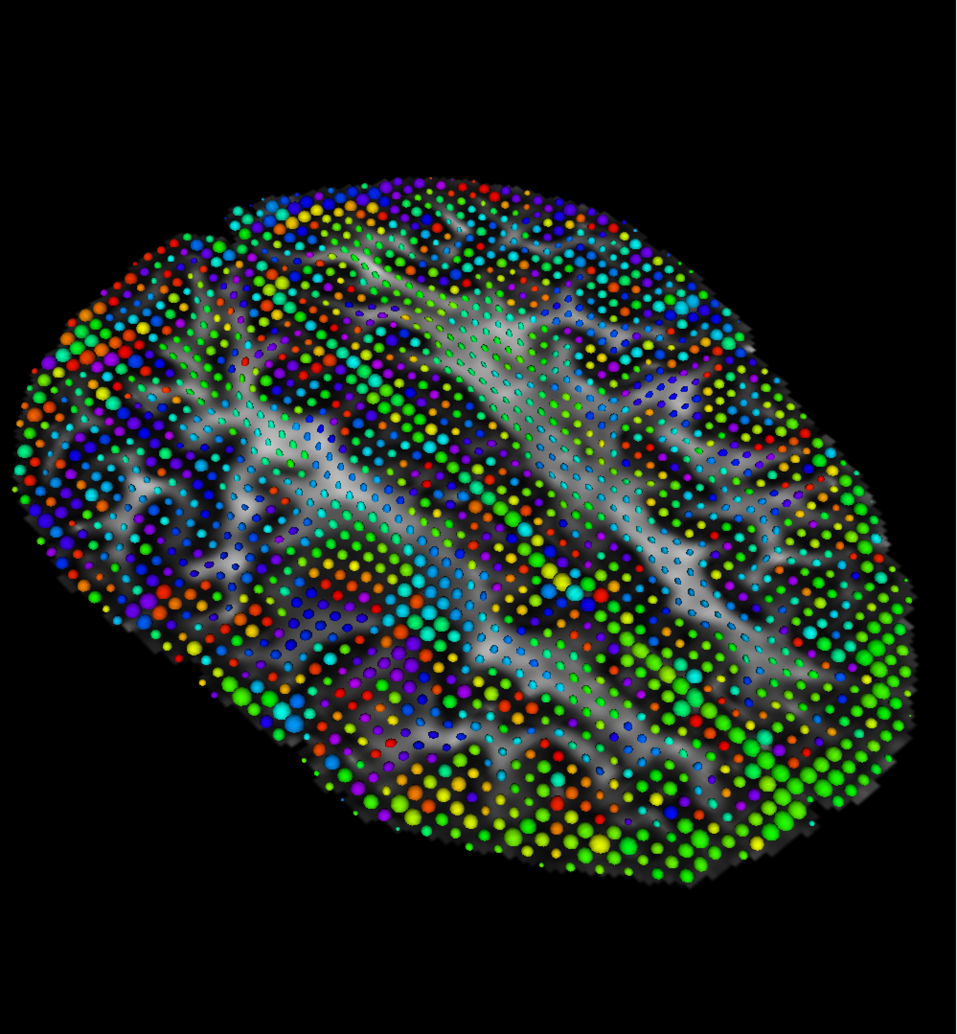
Diffusion Tensor Imaging (DTI)
First non-invasive window on white matter anatomy
Measurement of the motion of water molecules using MRI techniques.
Three-dimensional reconstruction of the trajectory of white matter bundles

Slide 5
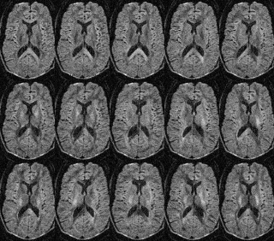
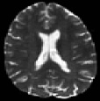
Diffusion Weighted Imaging (DWI)
S0
S0
S1
S2
S3
S4
S5
S6
S7
S8
S9
S10
S11
S12
In this example, the DWI scan was acquired with 12 diffusion sensitizing gradient directions (S1-S12) and 2 non-diffusion sensitizing gradients (S0)

Slide 6
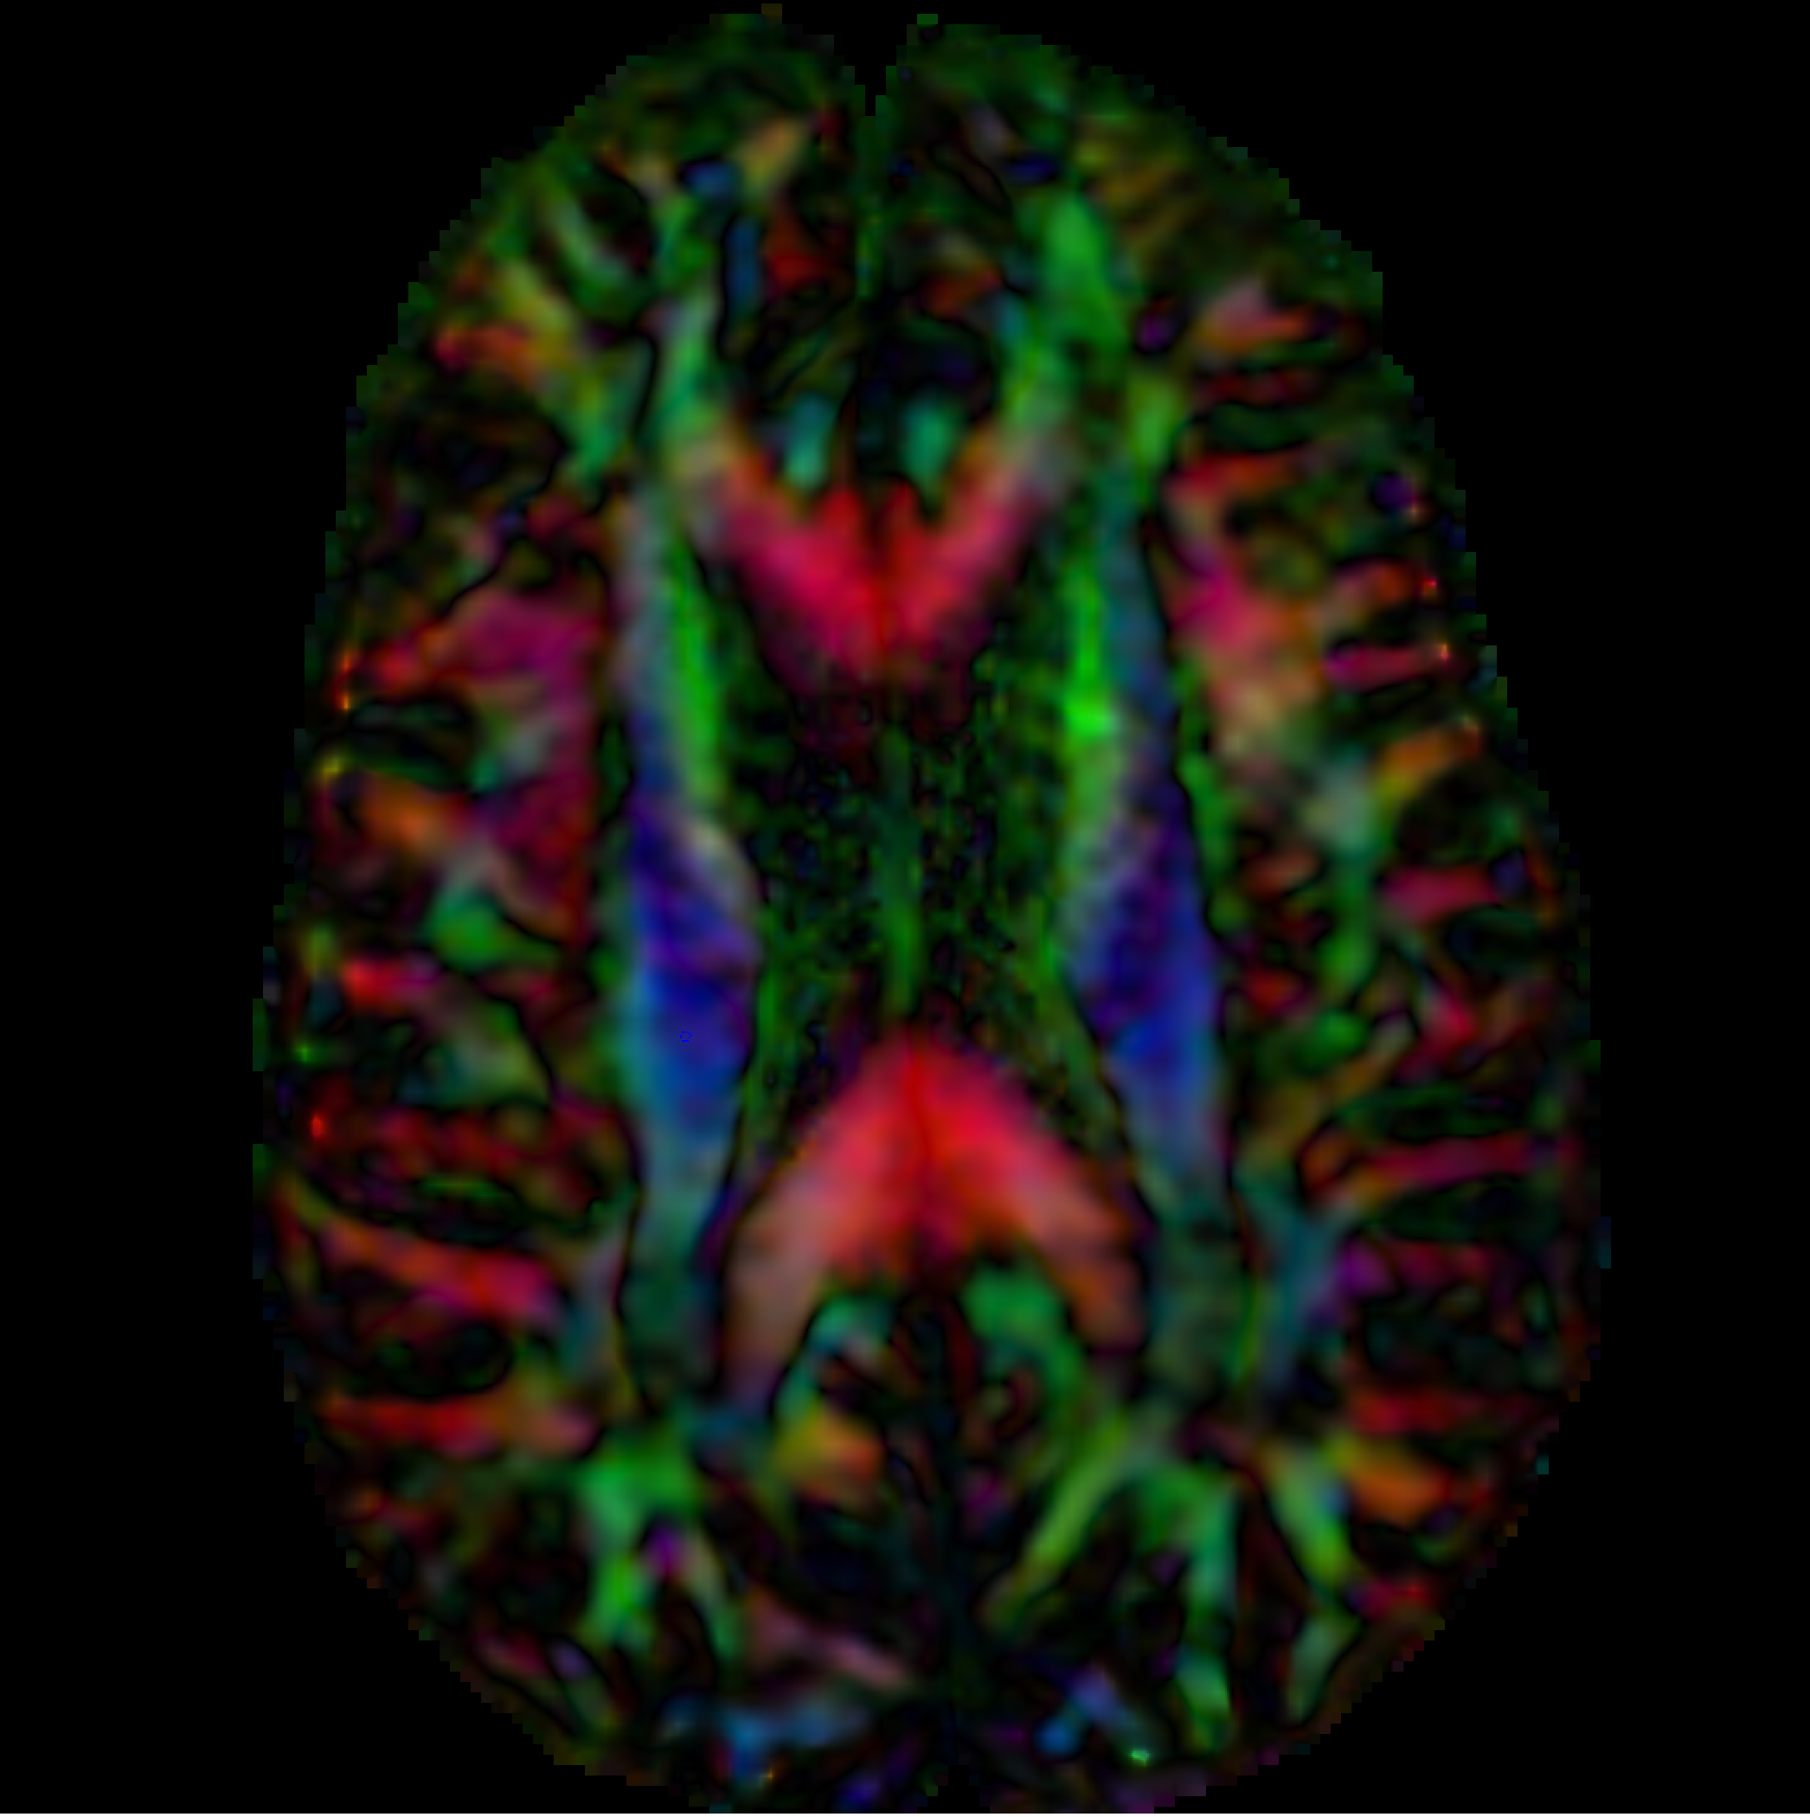
From DWI to DTI
DWI
DTI
S0
S0
S1
S2
S3
S4
S5
S6
S7
S8
S9
S10
S11
S12
DWI dataset acquired with 12 gradient and 2 baseline
DTI dataset
Si: DWI volume acquired with ith gradient
So: Baseline volume
Stejskal-Tanner (1965)

Slide 7
Diffusion Tensor Imaging

Slide 8
Diffusion Tensor Imaging
D
D
D
xx
xy
xz
D=
D
D
D
yx
yy
yz
D
D
D
zx
zy
zz

Slide 9
Diffusion Tensor Imaging
D
D
D
xx
xy
xz
D=
D
D
D
yx
yy
yz
D
D
D
zx
zy
zz
λ3
λ1
λ2

Slide 10
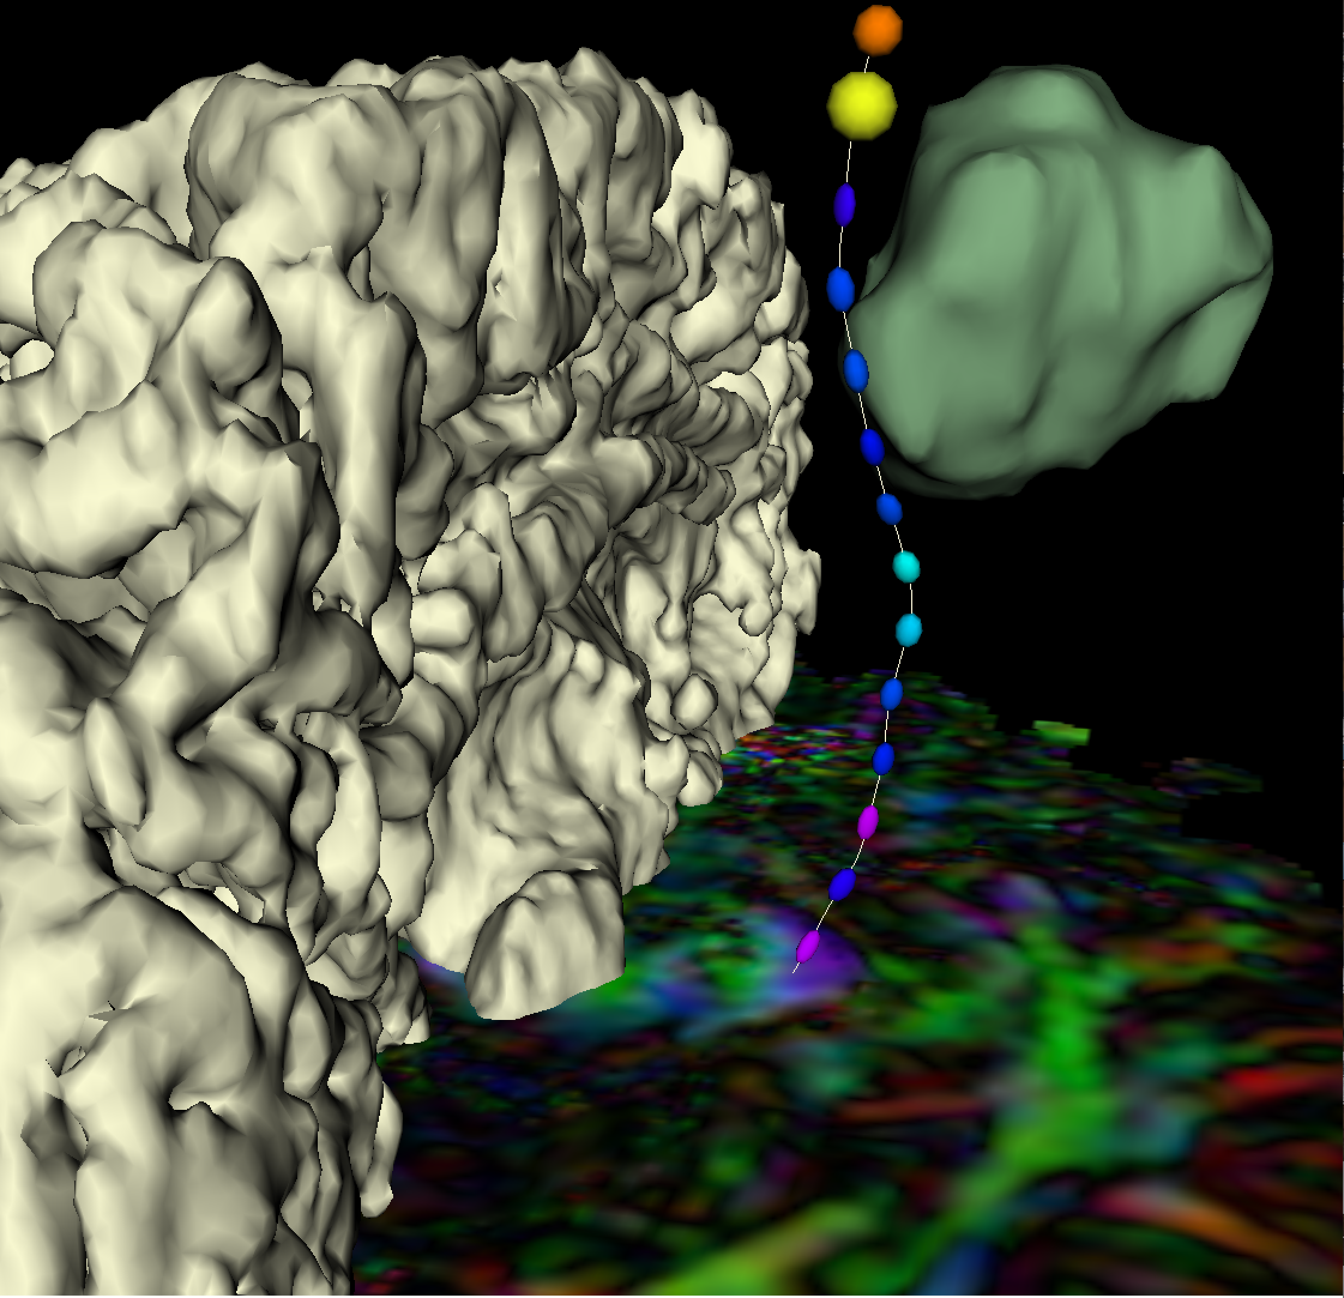
Tractography
DTI tractography provides 3D reconstruction of the trajectory of white matter pathways
Notes:
Tractography us tract finding algorithm

Slide 11
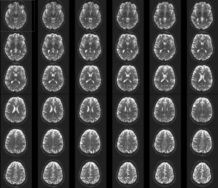
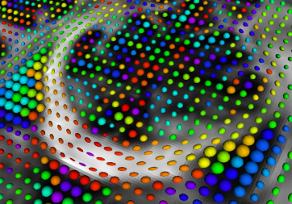
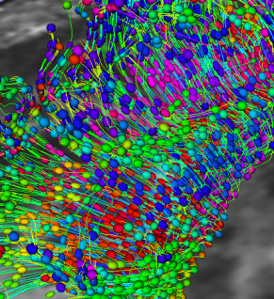
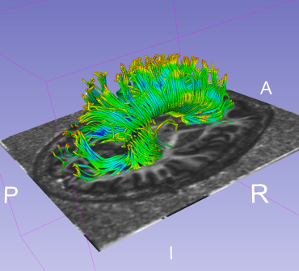
Tutorial Outline
This tutorial is an introduction to the fundamentals of Diffusion MRI analysis, from the estimation of diffusion tensors to the interactive 3D visualization of fiber tracts.

Slide 12

Tutorial Dataset
The tutorial dataset DiffusionMRI_tutorialData is a Diffusion Weighted MR scan of the brain acquired with 41 gradient directions and one baseline.
Diffusion Sensitizing Gradients
Diffusion Weighted Images
Download the dataset at:
https://www.slicer.org/w/images/e/e6/Dti_tutorial_data.zip

Slide 13
3D Slicer
The tutorial uses the 3D Slicer (Version 4.8.1, revision 26813, Stable Release) software available at:
http://download.slicer.org
Disclaimer
It is the responsibility of the user of 3DSlicer to comply with both the terms of the license and with the applicable laws, regulations and rules. Slicer is a tool for research, and is not FDA approved.

Slide 14
SlicerDMRI
An open-source project to improve and extend diffusion magnetic resonance imaging software in 3D Slicer:
http://dmri.slicer.org
Disclaimer
It is the responsibility of the user of 3DSlicer to comply with both the terms of the license and with the applicable laws, regulations and rules. Slicer is a tool for research, and is not FDA approved.

Slide 15
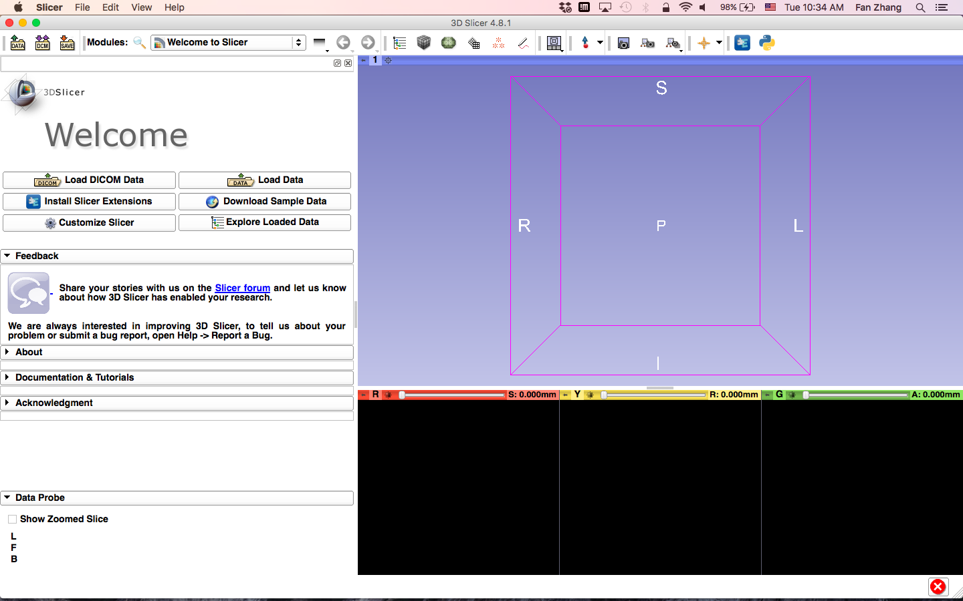
Install SlicerDMRI
First, start Slicer4

Slide 16
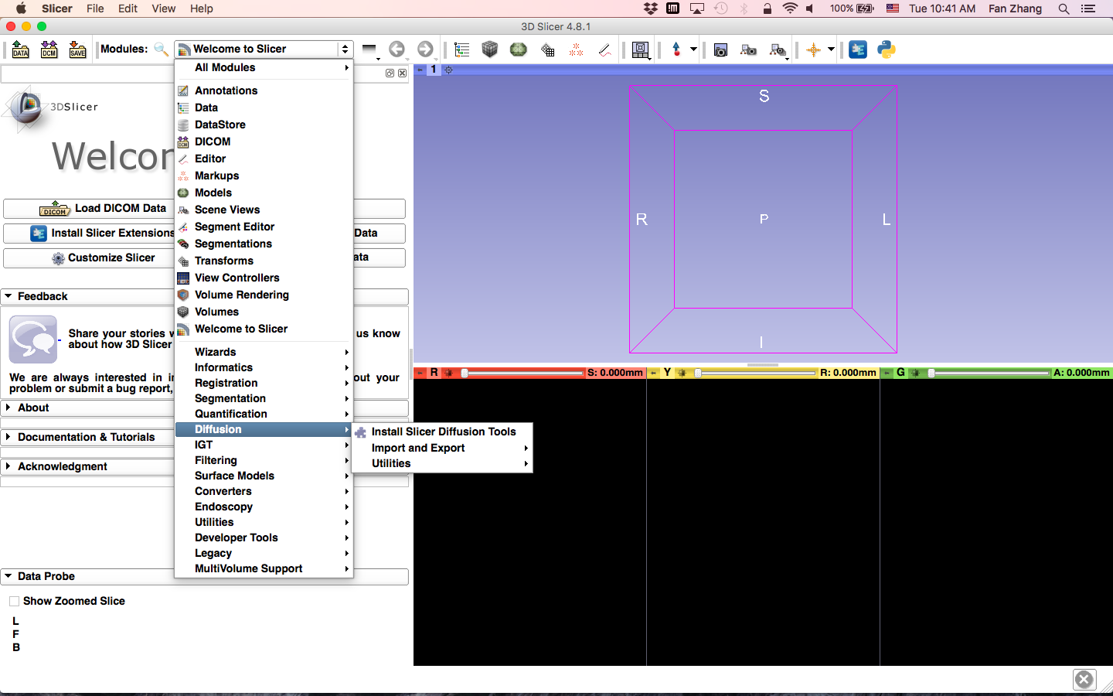
Install SlicerDMRI
Click on the Modules menu
Click on the Diffusion menu; then, click on Install Slicer Diffusion Tools

Slide 17
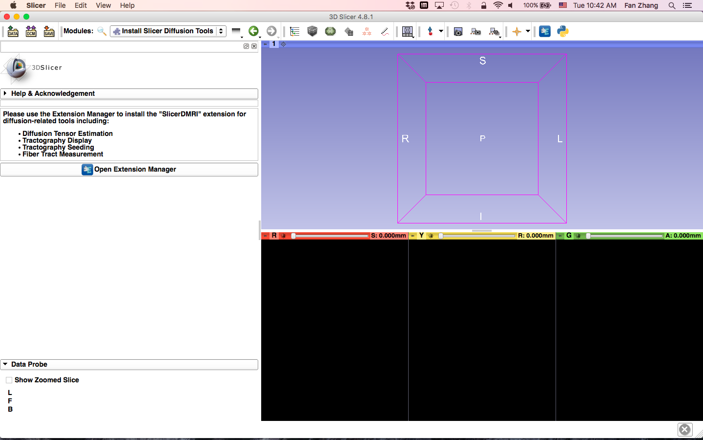
Install SlicerDMRI
Click on the Open Extension Manager menu

Slide 18
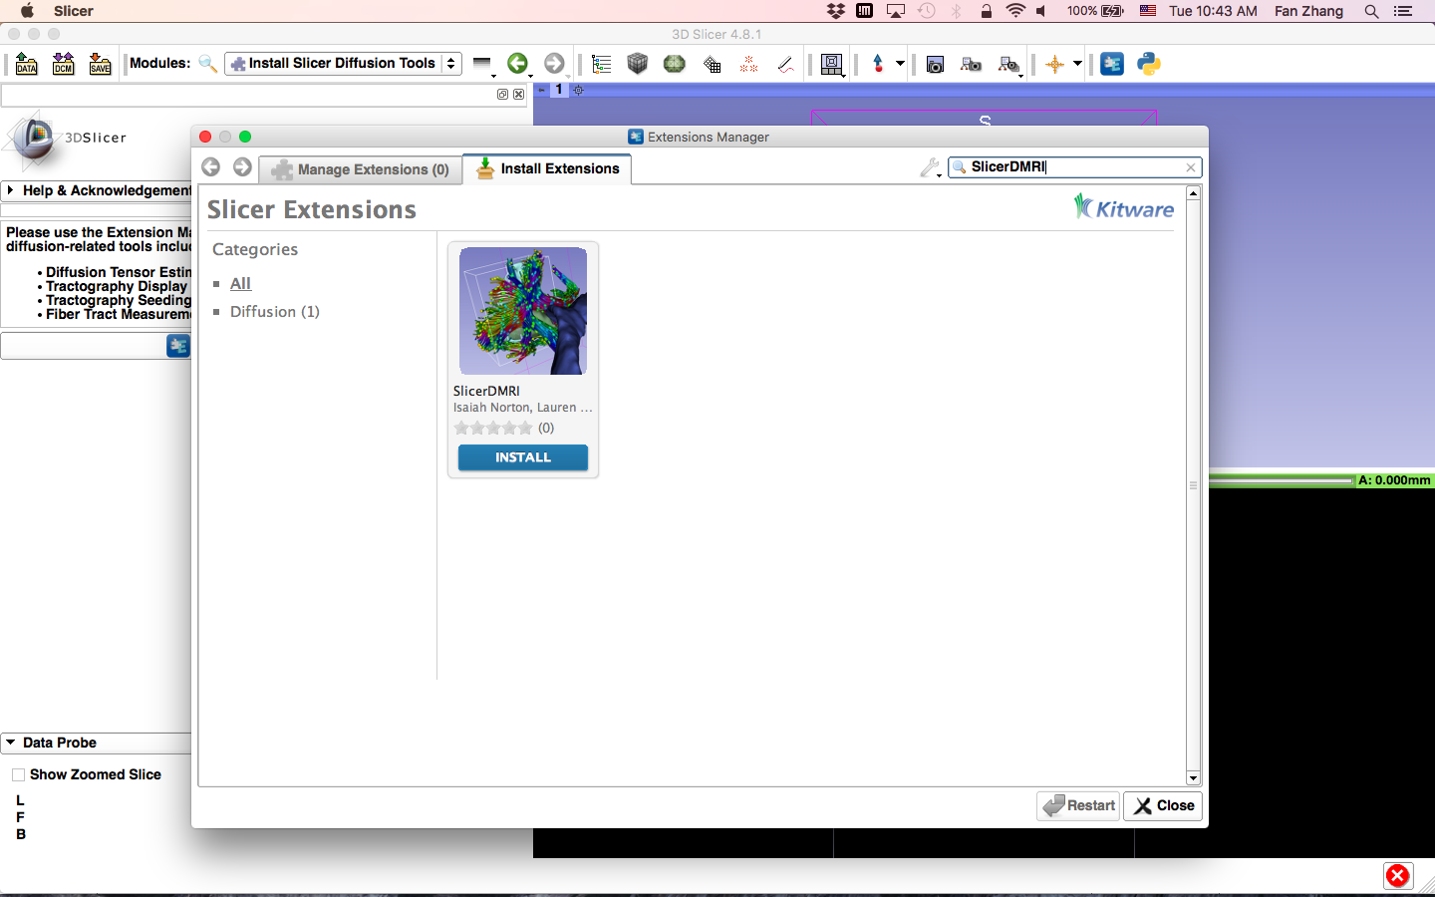
Install SlicerDMRI
Search for SlicerDMRI in Extension Manager
Click on SlicerDMRI to install

Slide 19
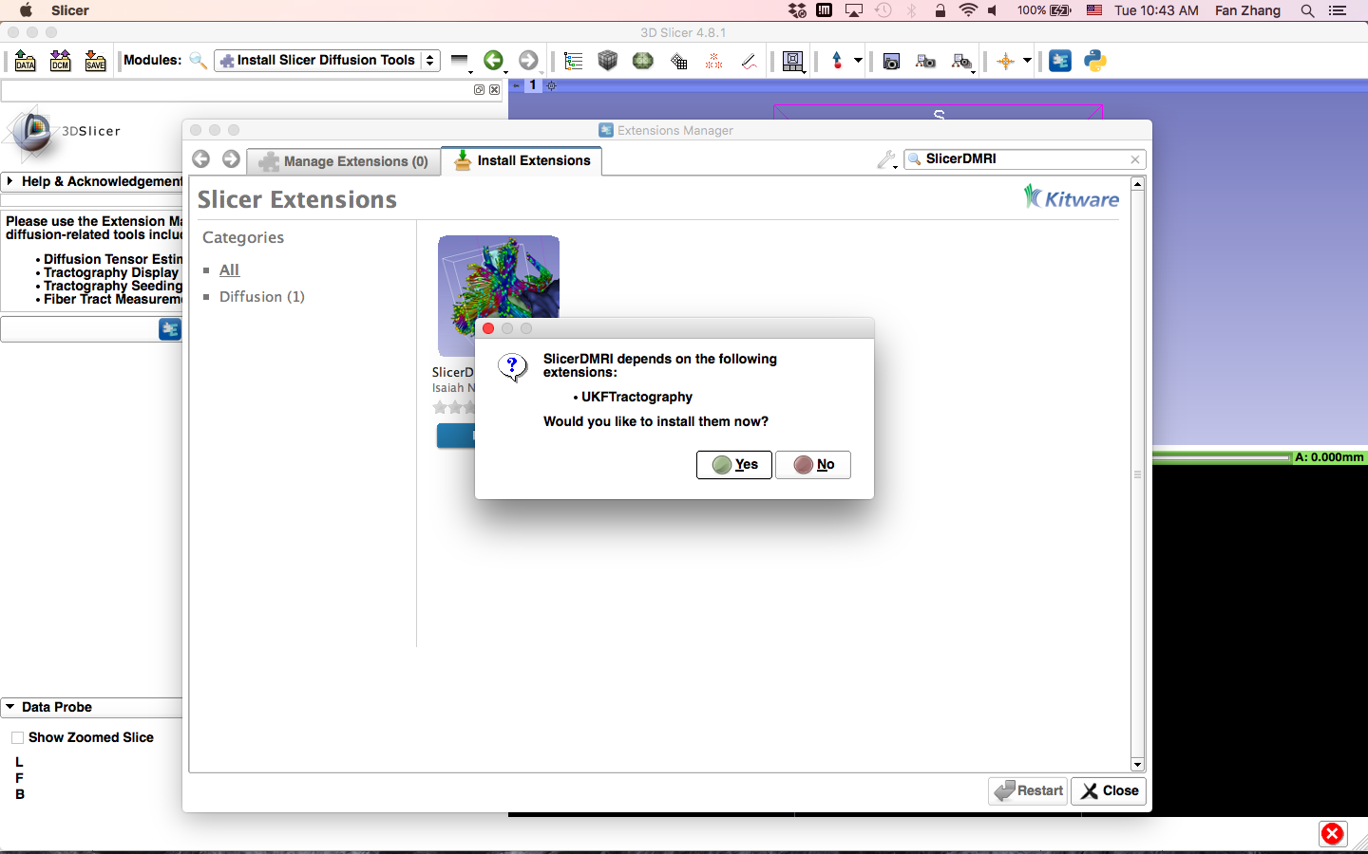
Install SlicerDMRI
Click Yes to install UKFTractography

Slide 20
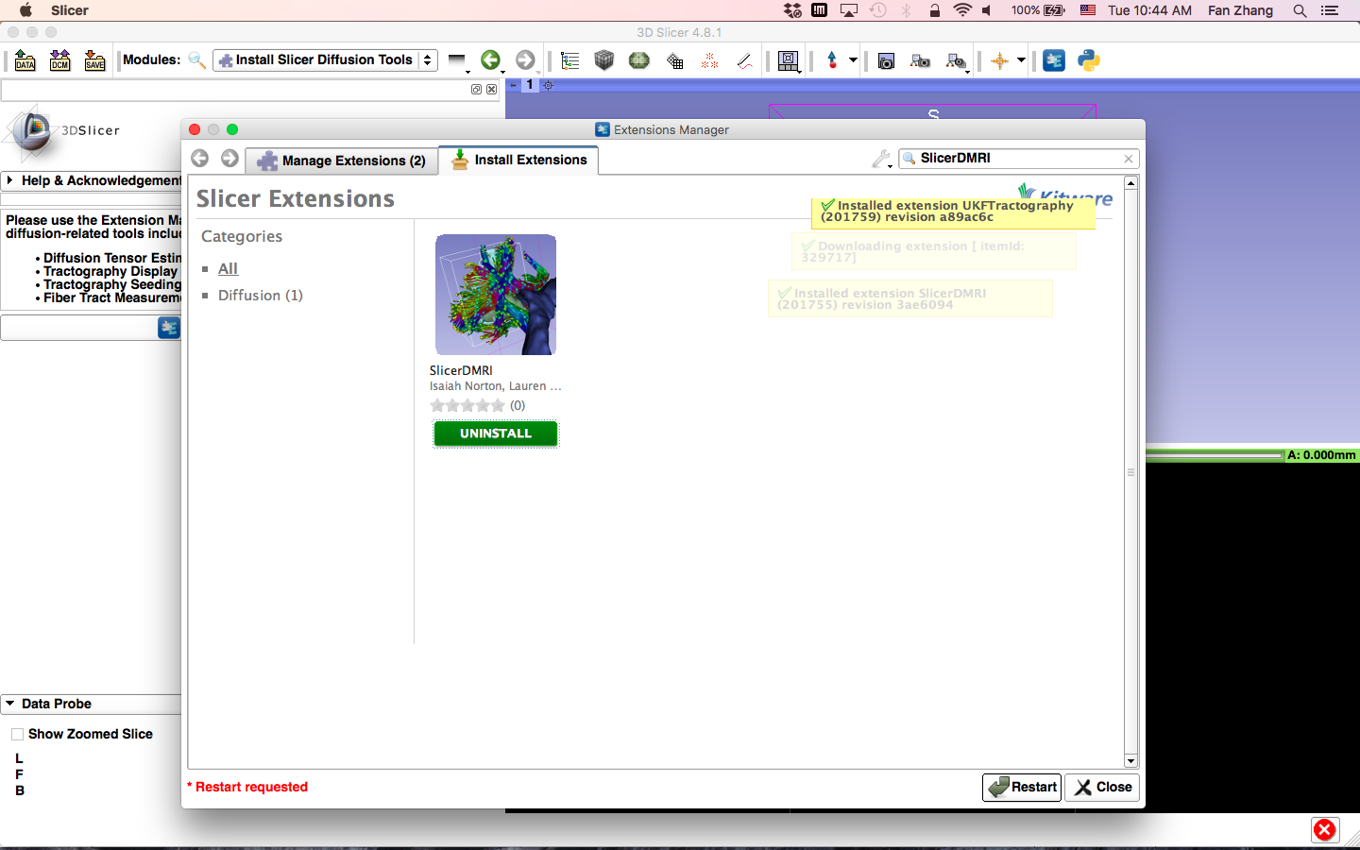
Install SlicerDMRI
Restart Slicer to finish installation

Slide 21
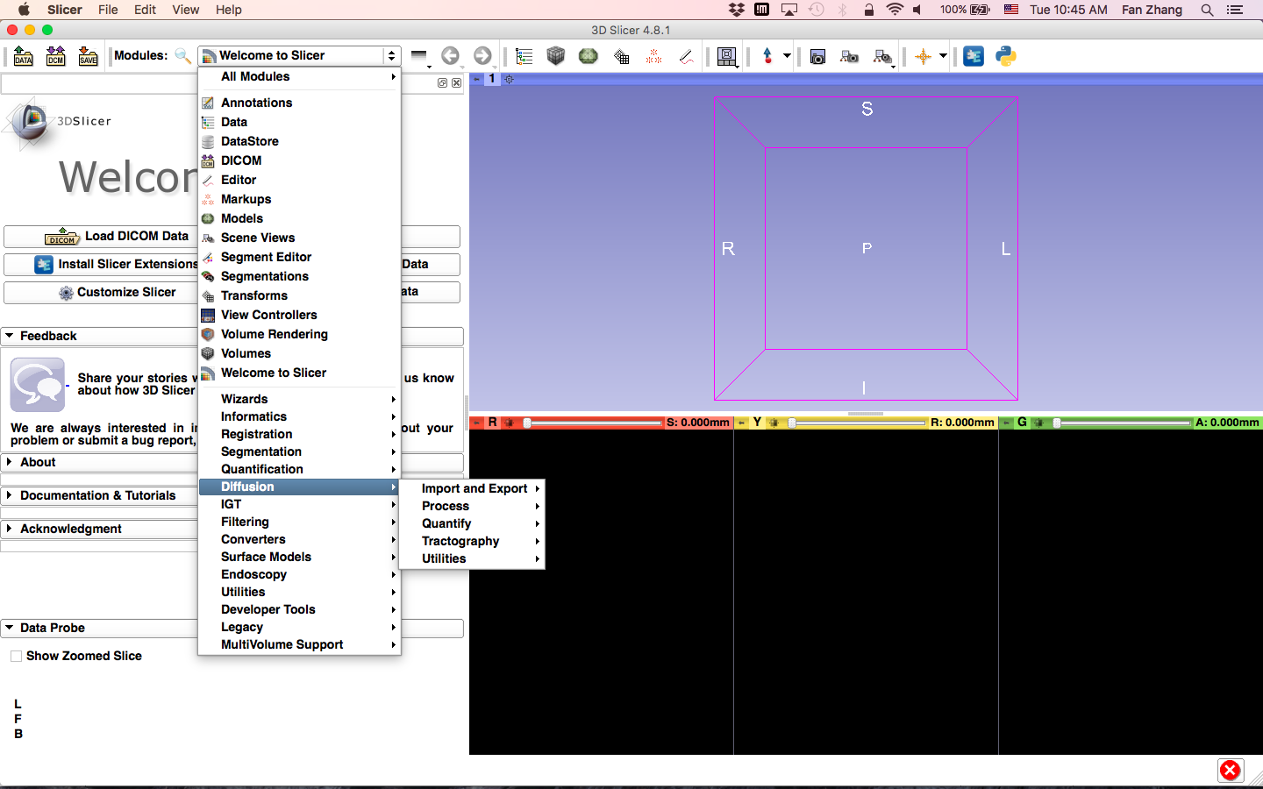
Install SlicerDMRI
Related modules appear in the Diffusion menu

Slide 22
Learning Objectives
Following this tutorial, you’ll be able to
1) Estimate a tensor volume from a set of Diffusion Weighted Images
2) Understand the shape and size of the diffusion ellipsoid
3) Reconstruct DTI tracts from a pre-defined region of interest
4) Interactively visualize DTI tracts seeded from a fiducial

Slide 23
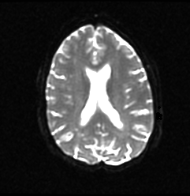
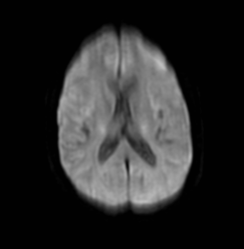
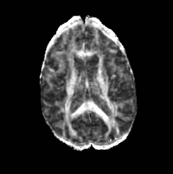
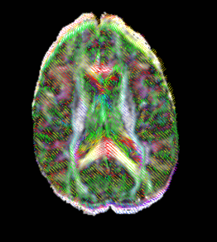
MR Diffusion Analysis Pipeline
DWI Acquisition
Tensor Calculation
Scalar Maps
3D Visualization

Slide 24
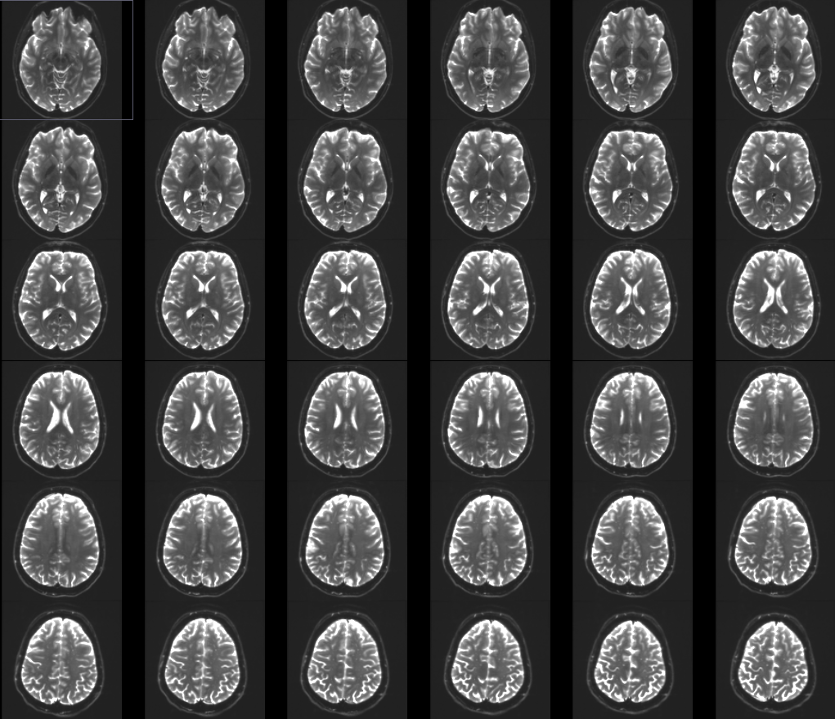
Part 1: From DWI images to Tensors

Slide 25
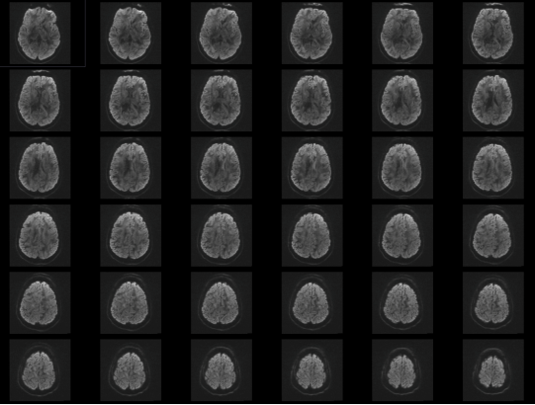
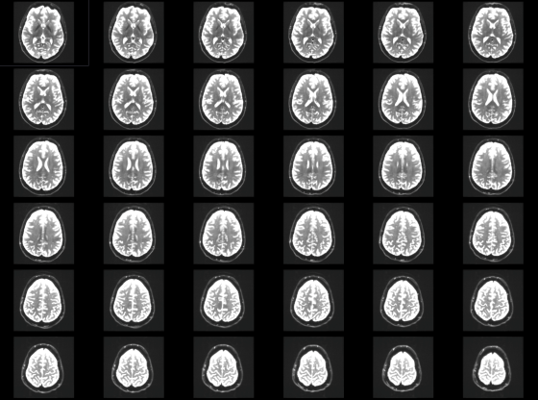
Understanding the DWI Dataset
….
The Diffusion Weighted Imaging (DWI) dataset is composed of 41 volumes acquired with 41 different diffusion-sensitizing gradient directions, and one baseline image acquired without diffusion weighting.

Slide 26
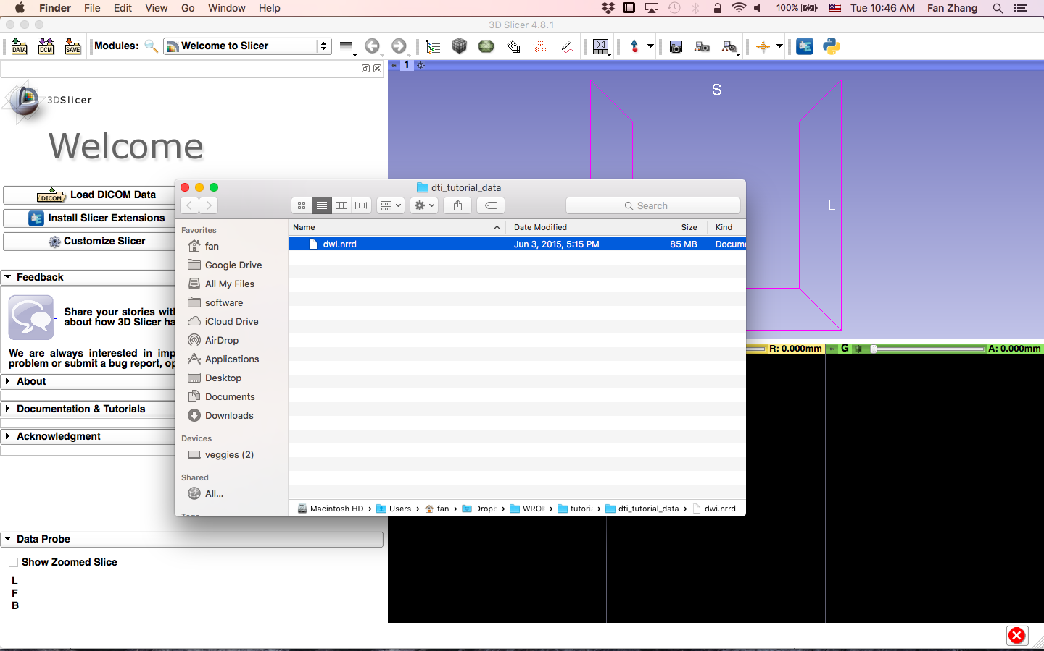
Loading the DWI Dataset
In your files archive, locate the file dwi.nrrd in the dataset folder for this tutorial
Drag and drop the file dwi.nrrd onto the viewer of the Slicer application

Slide 27
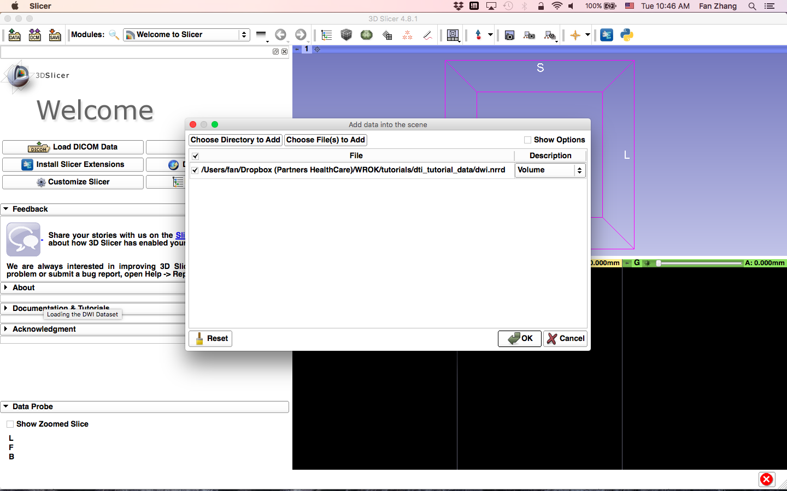
Loading the DWI Dataset
Exit the archive folders window, and click OK to load the dataset to Slicer

Slide 28
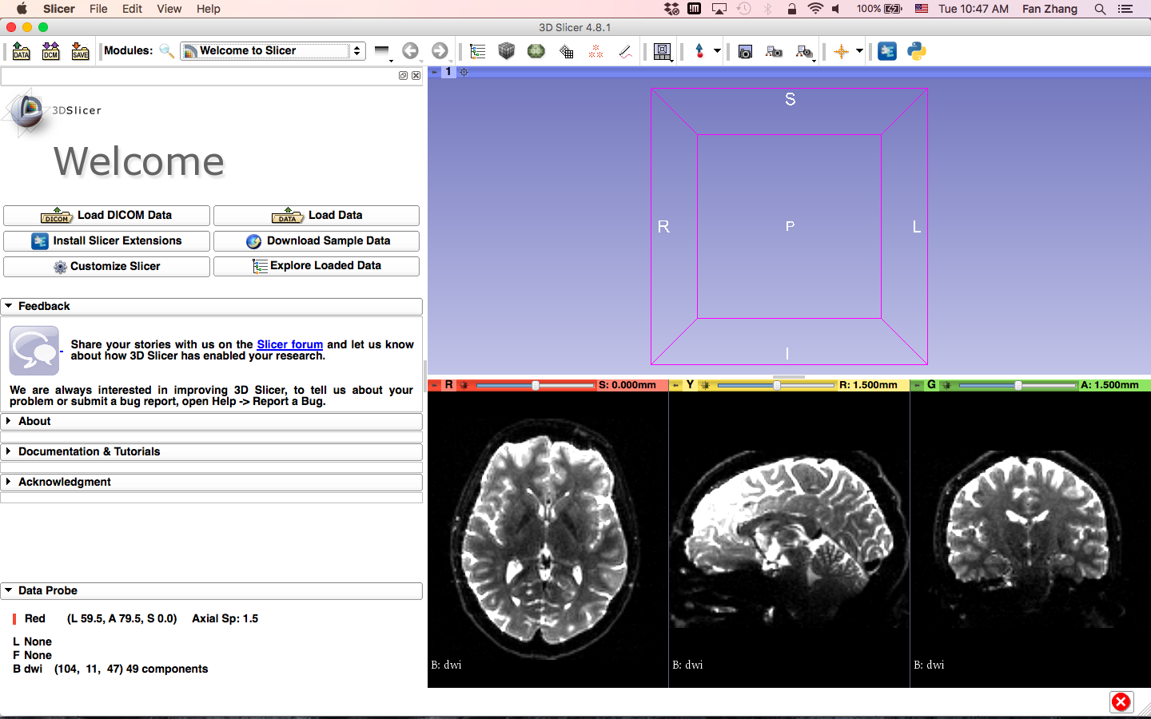
Loading the DWI Dataset
Slicer displays DWI volume of the brain

Slide 29
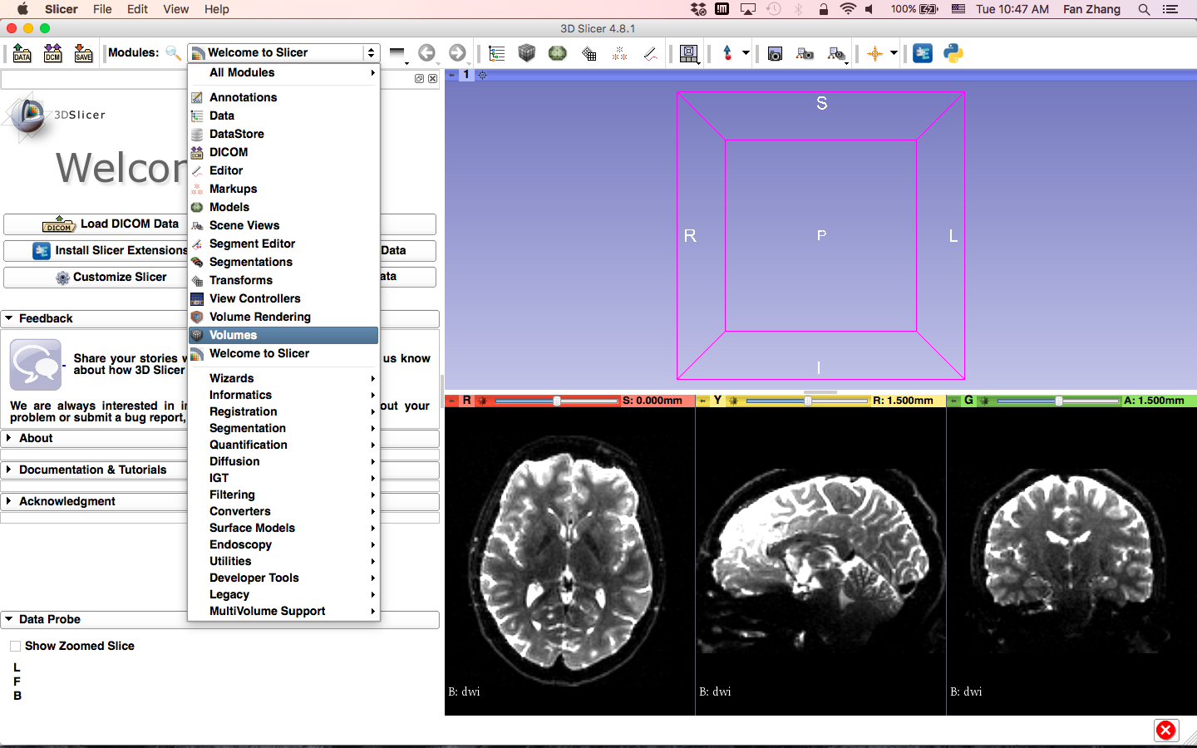
Loading the DWI Dataset
Click on the Modules menu and select the module Volumes

Slide 30
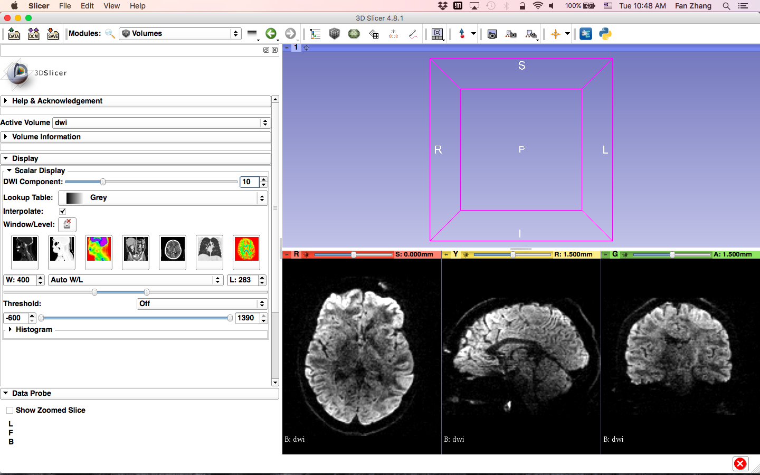
Loading the DWI Dataset
The baseline image corresponds to the DWI Component #0.
Select the DWI Component #10, which corresponds to the 10th diffusion sensitizing gradient

Slide 31

Loading the DWI Dataset
For image contrast adjustment, you may use the Manual W/L slider.

Slide 32
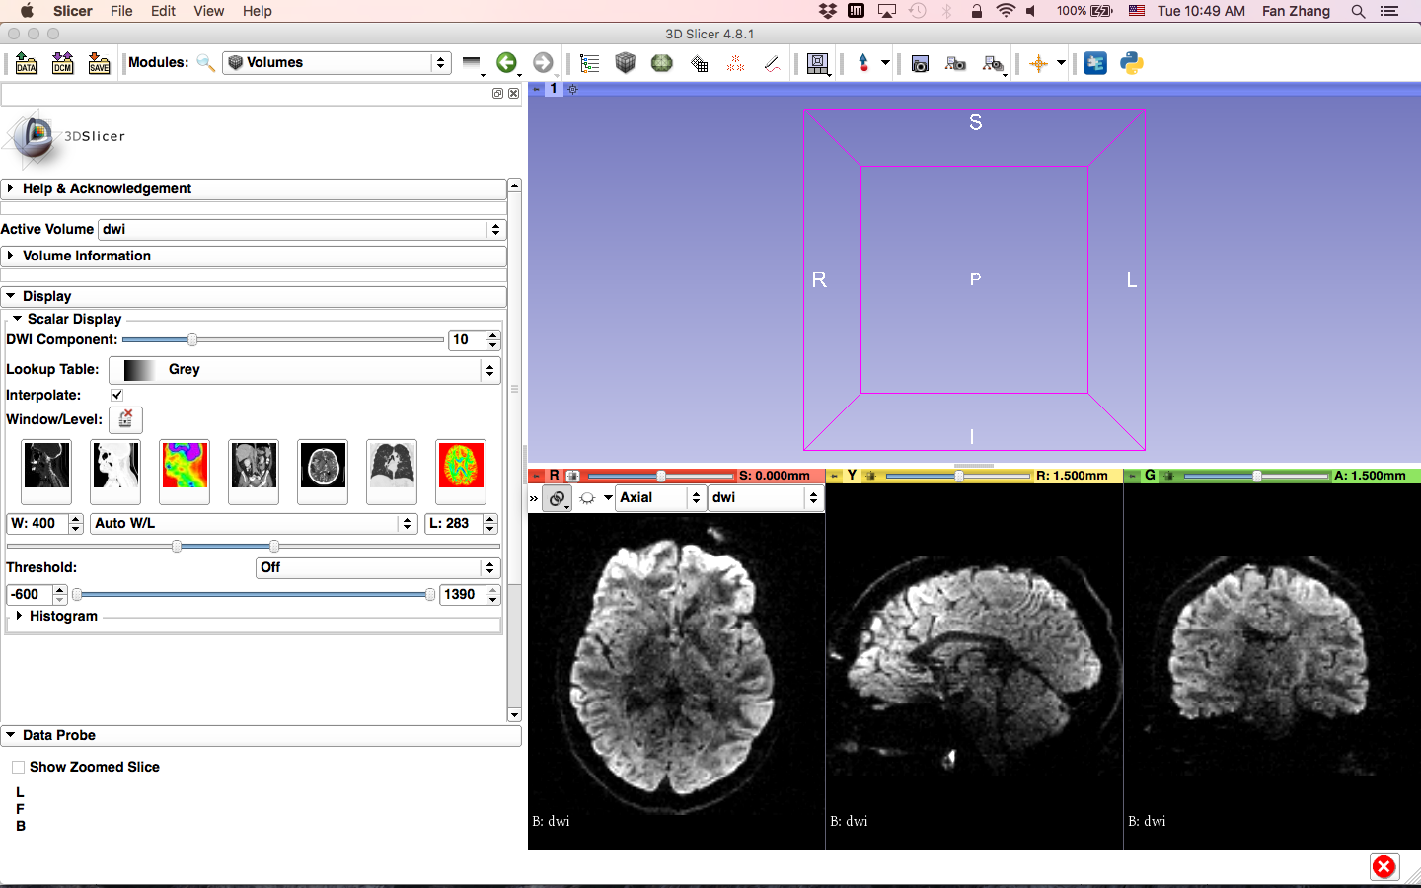
Loading the DWI Dataset
Position your mouse over the pin icon, then click on the link icon and the fit image to window icon

Slide 33
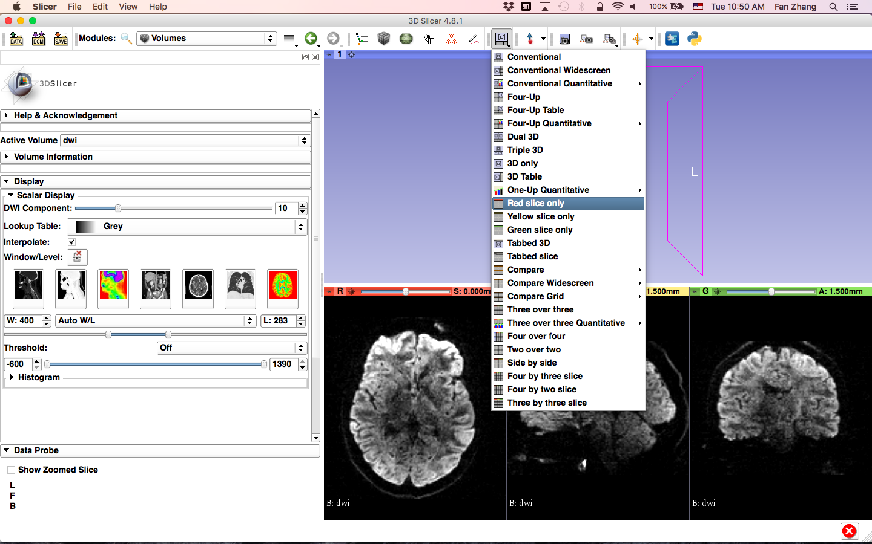
Loading the DWI Dataset
Click on the Slicer layout menu and select the Red slice only layout

Slide 34
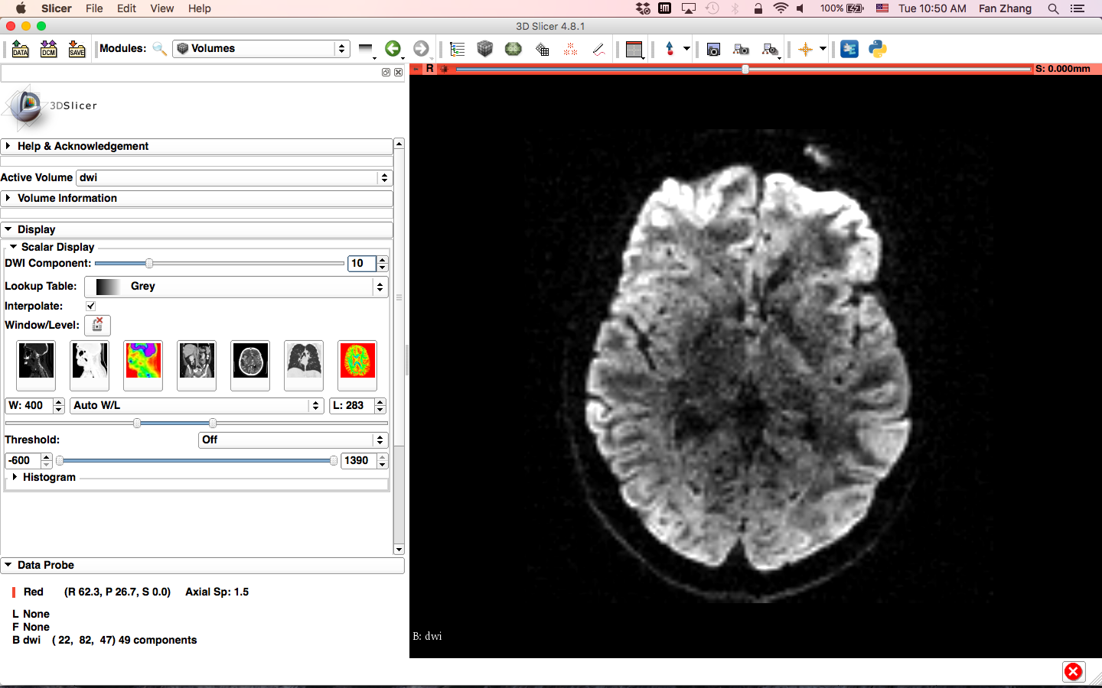
Loading the DWI Dataset
Slicer displays only the Axial anatomical slice in the Viewer

Slide 35
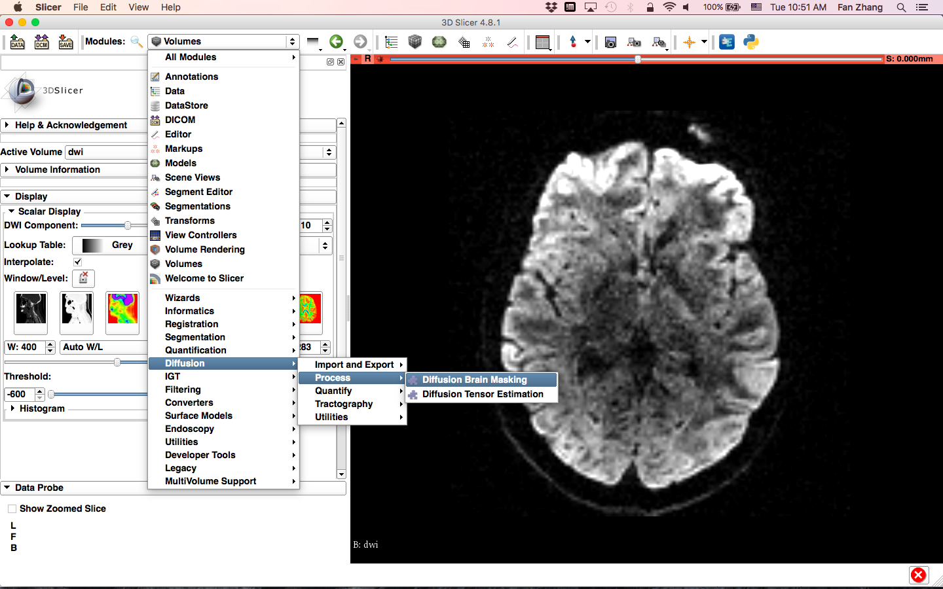
Creating a brain mask
Click on the Modules menu, then select Diffusion -> Process -> Diffusion Brain Masking

Slide 36
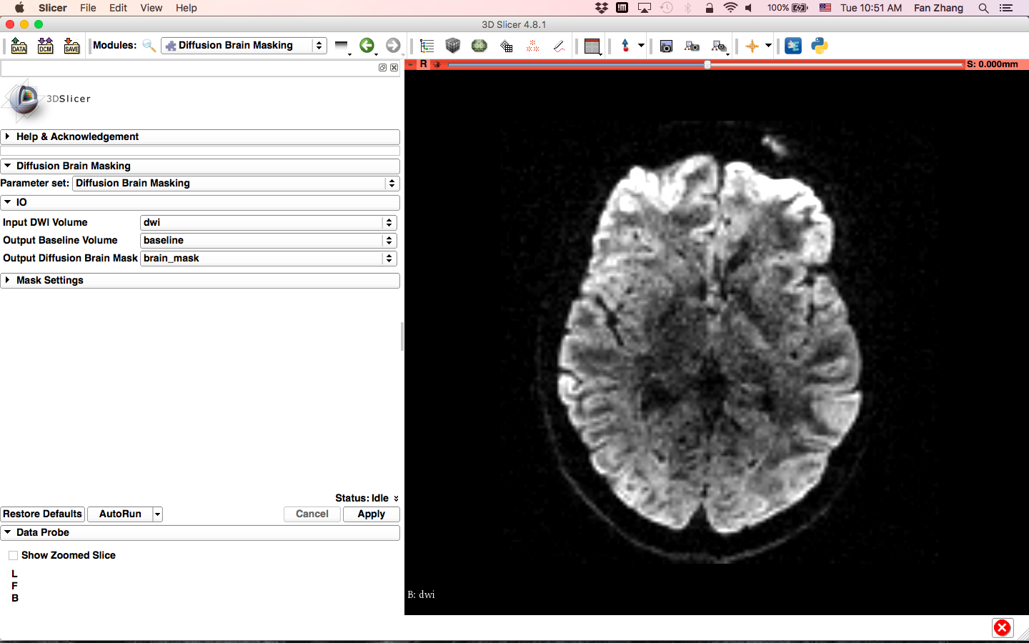
Creating a brain mask
-select the Input DWI volume ‘dwi’
-select Output Baseline Volume ‘Create new Volume as...’, and name it ‘baseline’
-select Output Diffusion Brain Mask ‘Create new LabelMapVolume as...’, and name it ‘brain_mask’
-click on Apply.

Slide 37
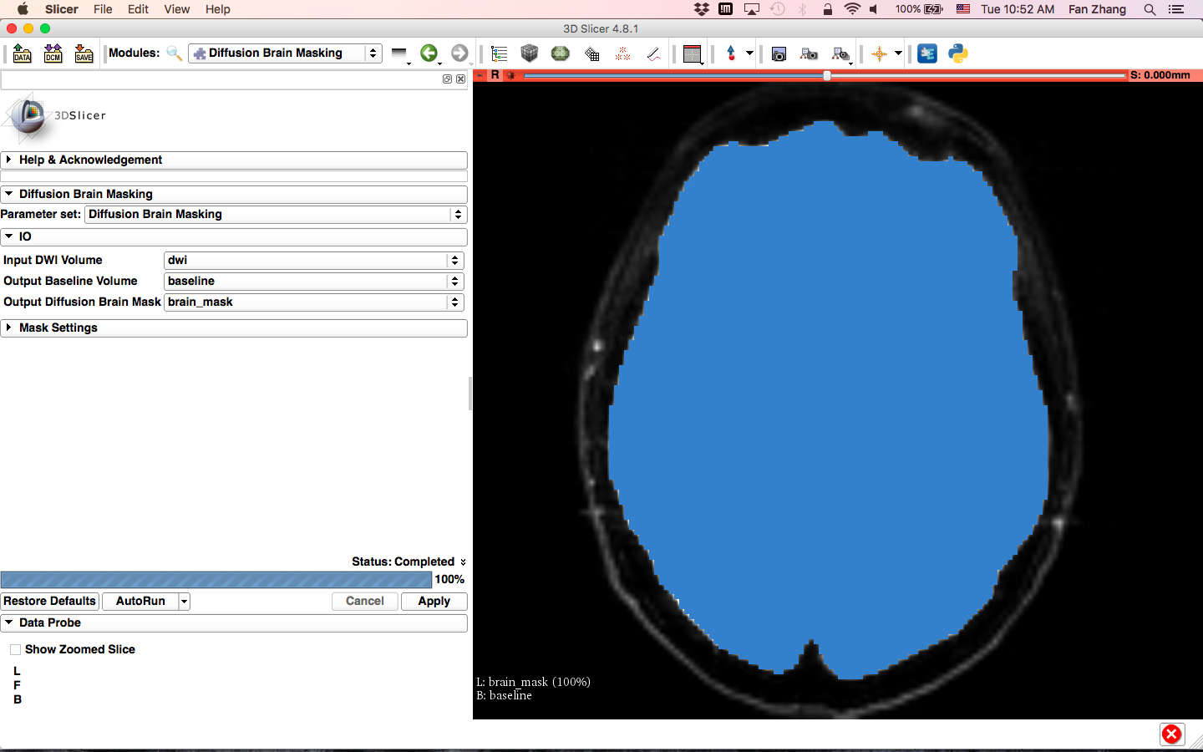
Creating a brain mask
Slicer displays the edited brain mask

Slide 38
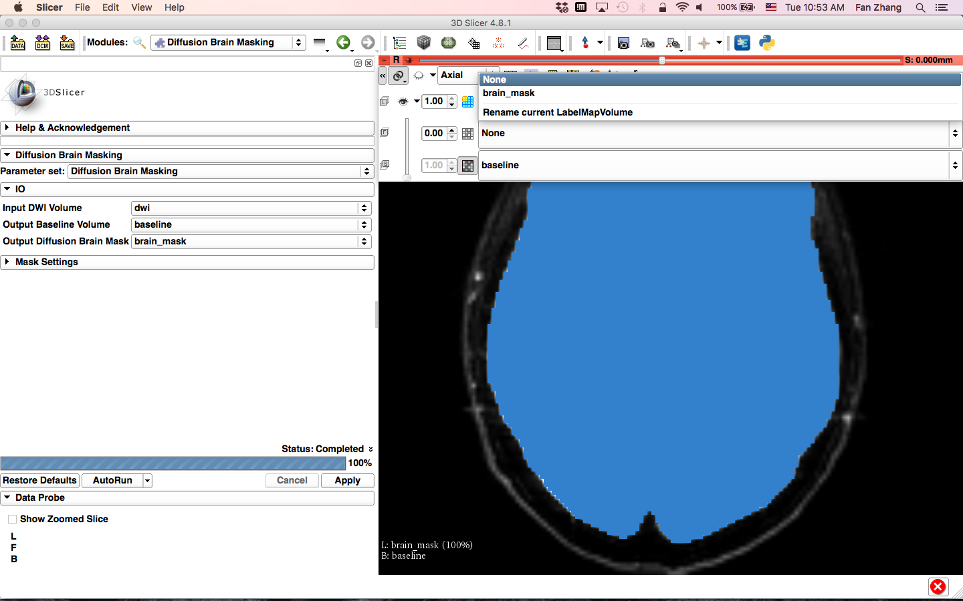
Creating a brain mask
Change the label layer to None to make the mask invisible

Slide 39
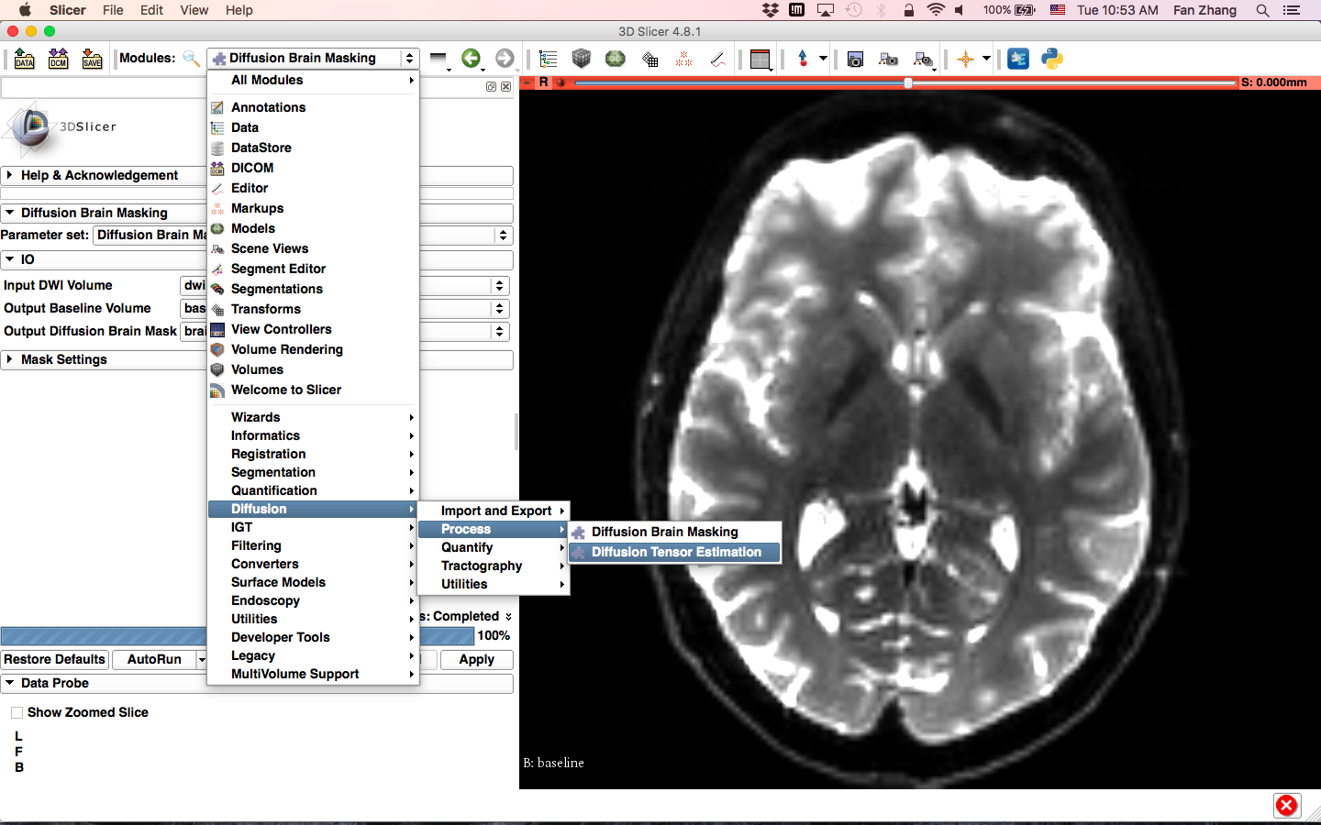
Estimating the tensor
Click on the Modules menu, then select Diffusion -> Process -> Diffusion Tensor Estimation

Slide 40
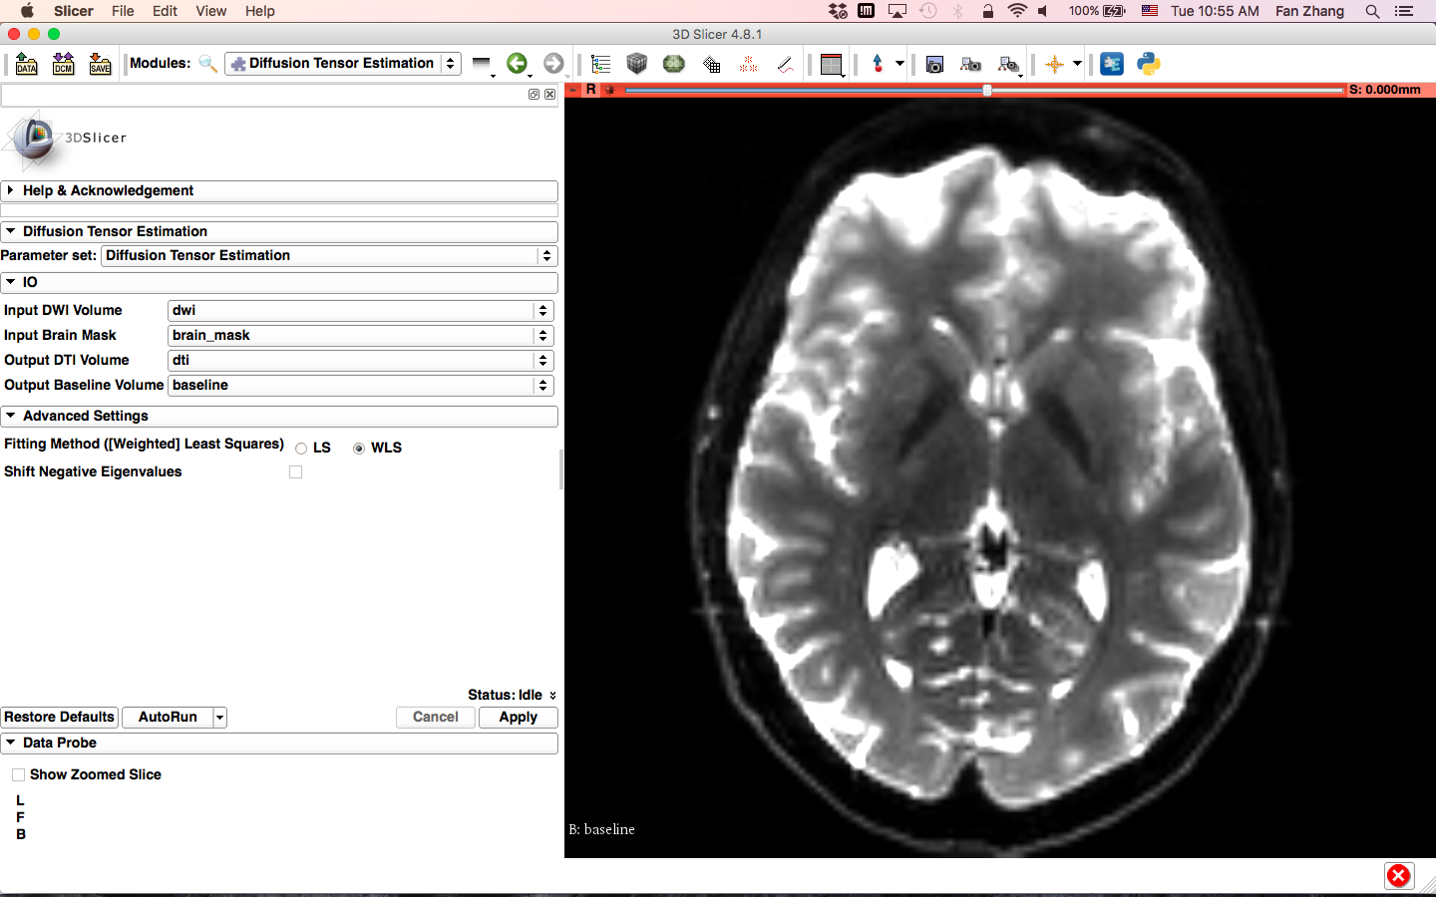
Estimating the tensor
-Set the Input DWI volume to ‘dwi’
-Set the Input Brain Mask to ‘brain_mask’
- Select Output DTI Volume ‘Create DiffusionTensorVolume as ...’, and name it ‘dti’
-Set Output Baseline Volume to ‘baseline’
-Under ‘Advanced Settings’, set Fitting Methods to ‘WLS’ (Weighted Least Squares)
-Click on Apply.

Slide 41
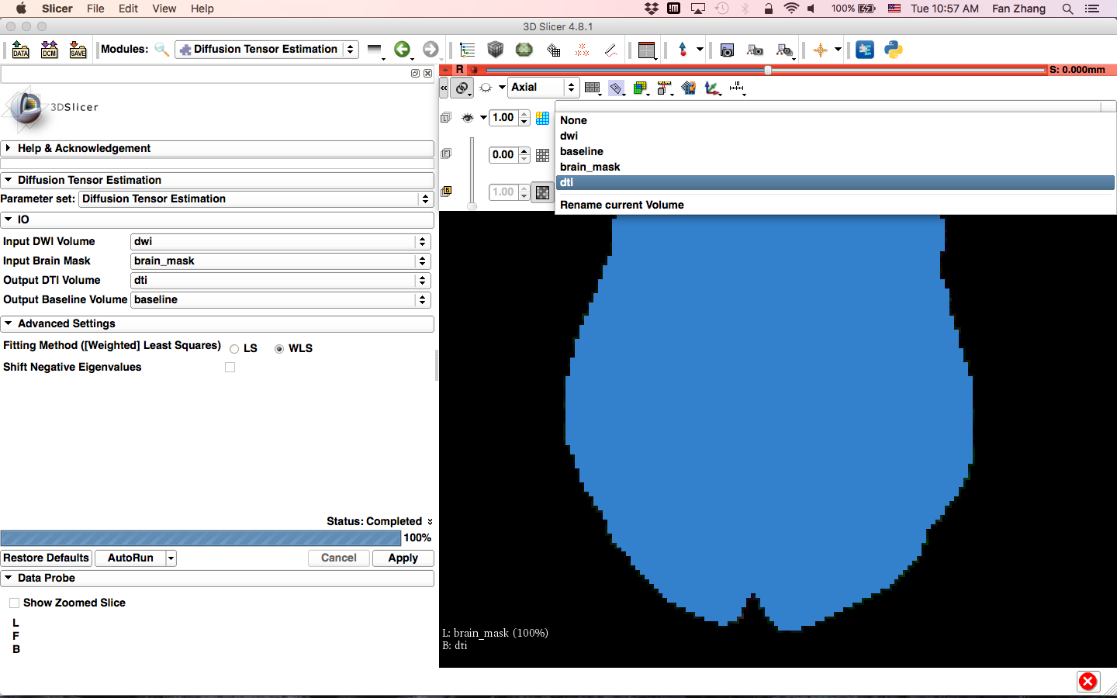
Estimating the tensor
Position your mouse over the pin icon, click on the double arrow and select the dti in the B field, set the F and L to none.

Slide 42
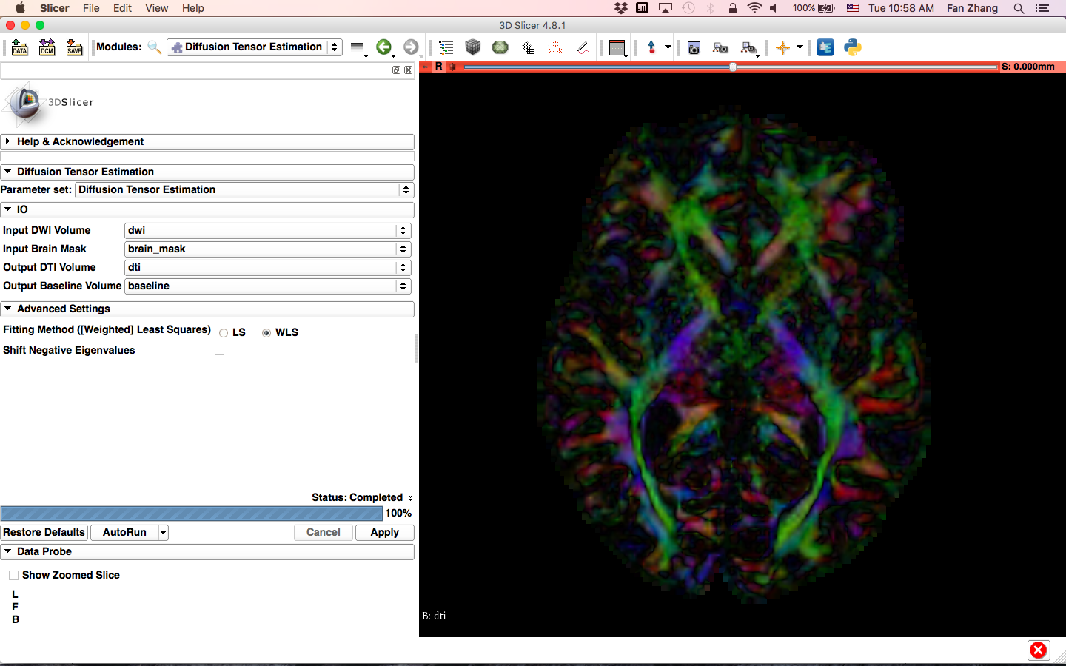
Exploring the DWI Dataset
Slicer displays the DTI volume in color by orientation mode:
Red: right-left
Green: anterior-posterior
Blue: inferior-superior

Slide 43
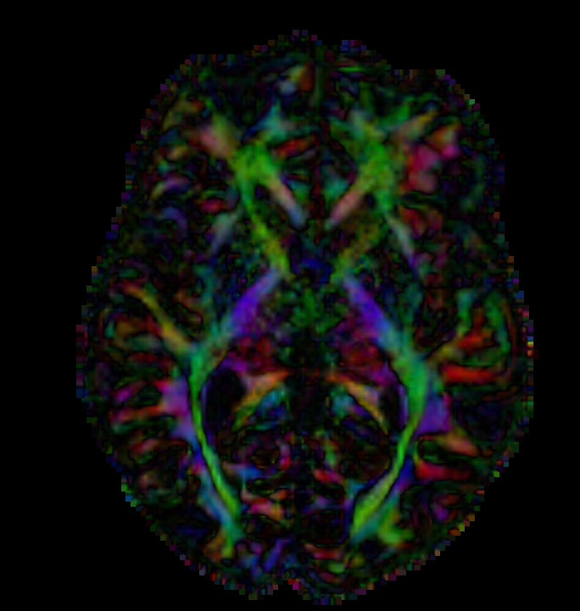
Diffusion Tensor Data
Stejskal-Tanner equation (1965)
D
D
D
xx
xy
xz
D=
D
D
D
yx
yy
yz
D
D
D
zx
zy
zz
The diffusion tensor D in the voxel (I,J,K) is a 3x3 symmetric matrix.

Slide 44
Diffusion Tensor
The diffusion tensor D in each voxel can be visualized as a diffusion ellipsoid, with the eigenvectors indicating the directions of the principal axes, and the ellipsoidal proportional to the square root of the eigenvalues defining the
λ3
Scalar maps can be derived from the rotationally invariant eigenvalues λ1, λ2, λ3 to characterize the size and shape of the diffusion tensor.
λ1
λ2

Slide 45
Diffusion Tensor Shape
λ1= λ2= λ3
λ1>> λ2, λ3
λ1~λ2>> λ3
Isotropic media
(Cerebrospinal Fluid, gray matter)
Anisotropic media
(white matter)

Slide 46
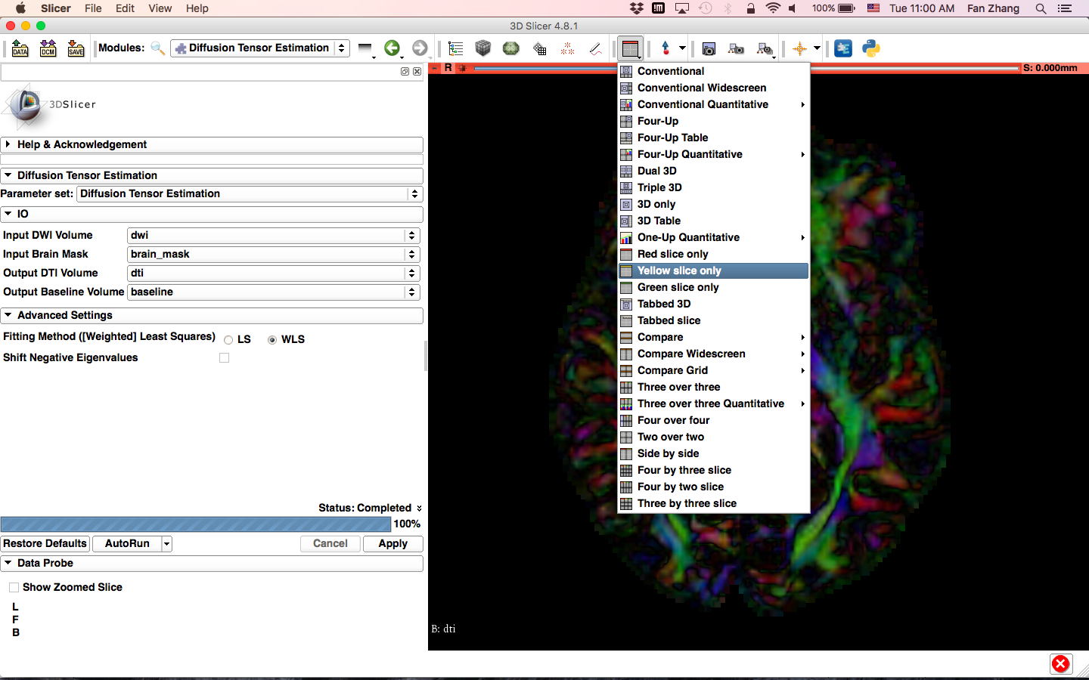
Exploring the DWI Dataset
Click on the Slicer layout menu and select the Yellow slice only layout.

Slide 47
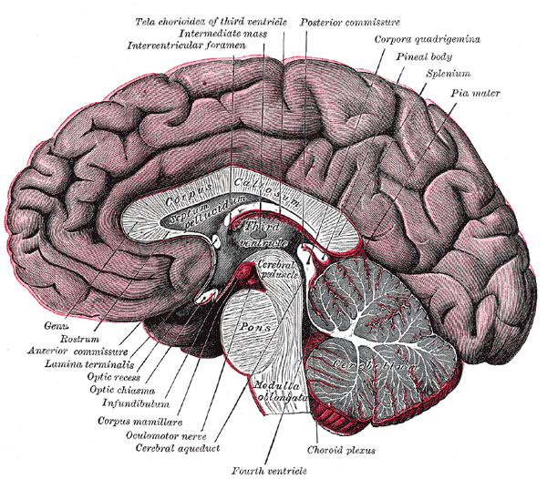
Corpus Callosum
The corpus callosum is a broad thick bundle of dense myelinated fibers that connect the left and right hemisphere. It is the largest white matter structure in the brain
Image from Gray’s Anatomy

Slide 48
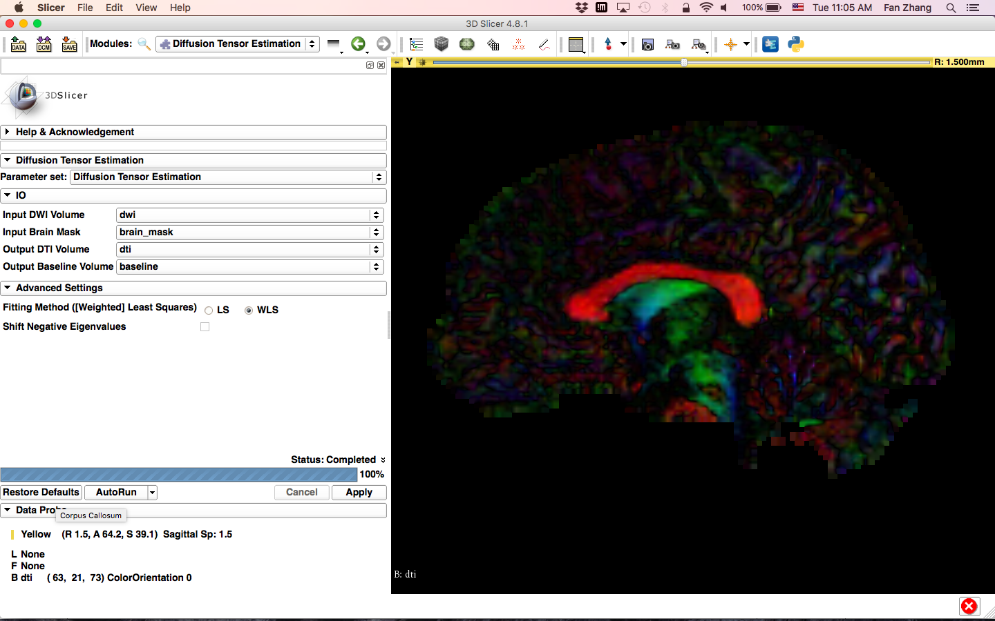
Corpus Callosum
Corpus Callosum

Slide 49
Characterizing the Size of the tensor: Trace
Trace(D) = λ1+ λ2+λ3
Trace(D) is intrinsic to the tissue and is independent of fiber orientation, and diffusion sensitizing gradient directions
Trace(D) is a clinically relevant parameter for monitoring stroke and neurological condition (degree of structural coherence in tissue)
Trace(D) is useful to characterize the size of the diffusion ellipsoid

Slide 50
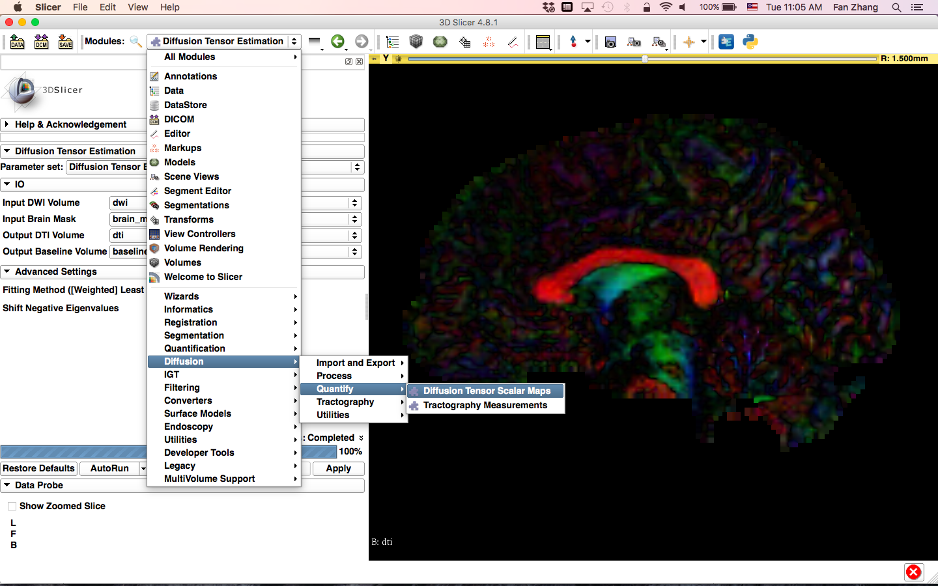
Trace
Click on the Modules menu, then select Diffusion -> Quantify -> Diffusion Tensor Scalar Maps

Slide 51
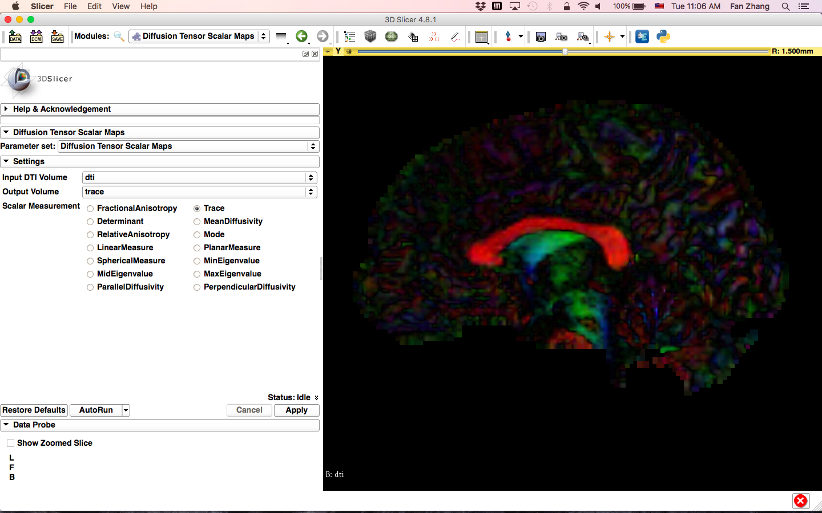
Trace
Type in the following information in the IO menu:
-select the Operation ‘Trace’
-set Input DTI Volume to ‘dti’
-select Output Volume ‘Create new Volume as...’ and name it ‘trace’
-click on Apply to calculate the trace map of the tensor volume

Slide 52
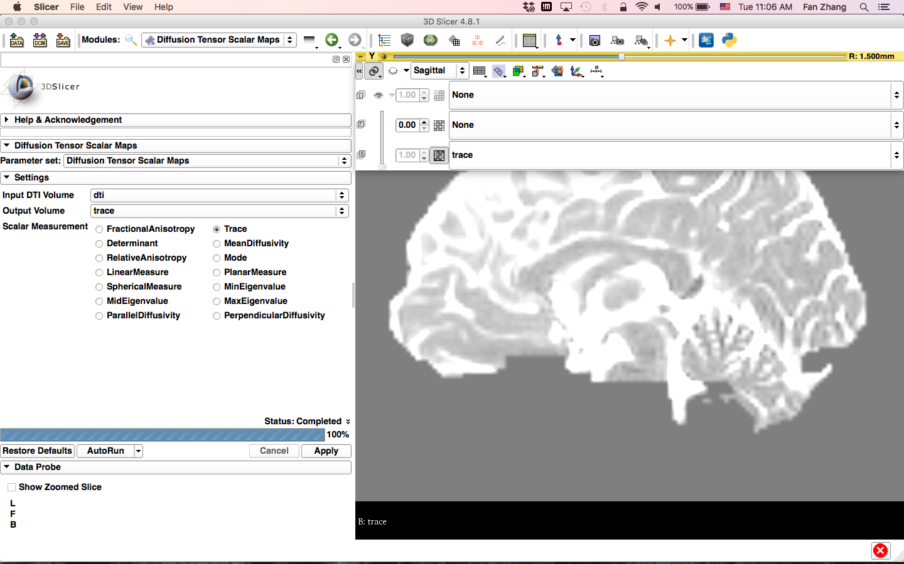
Trace
Set L as none.
The trace image appears in the yellow viewer

Slide 53
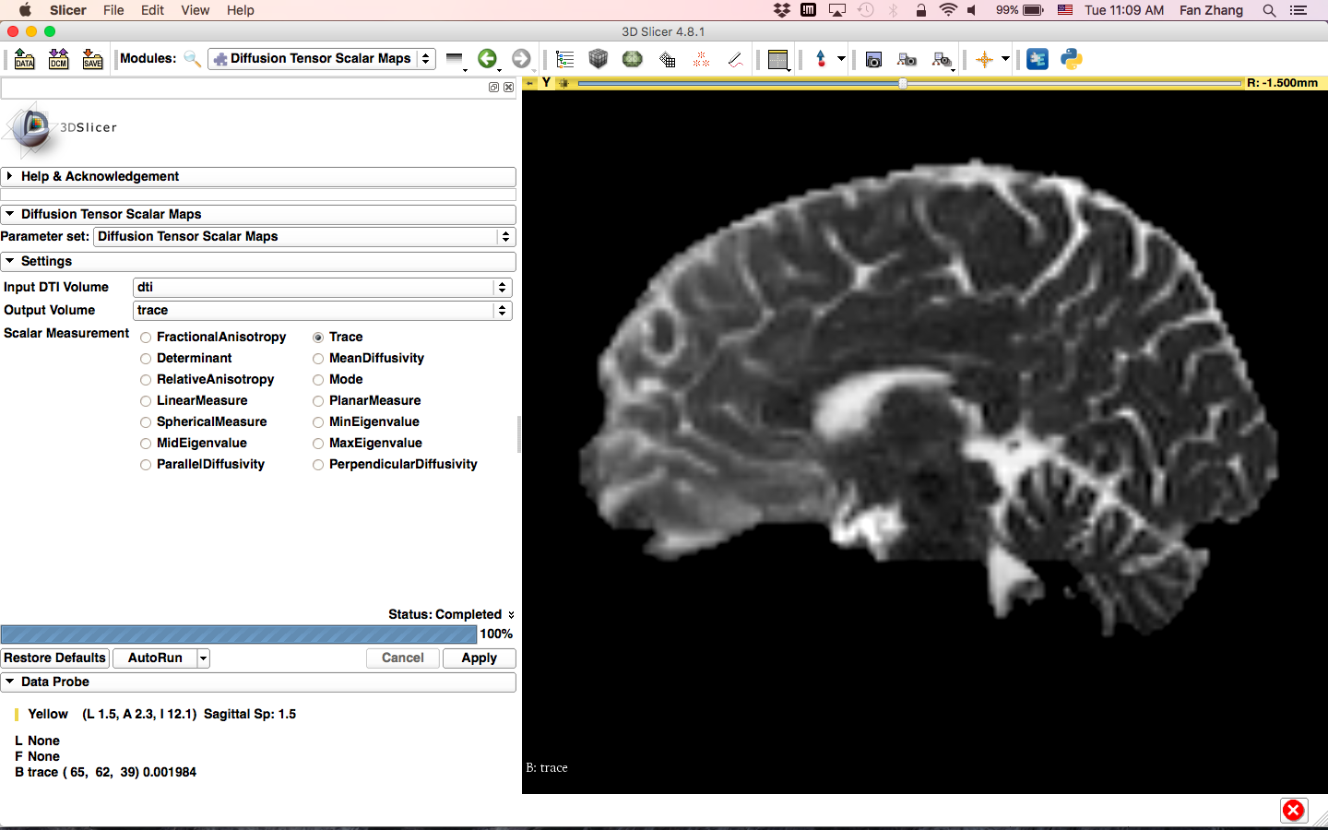
Trace
Adjust window level by right-dragging up and down.

Slide 54

Trace
Position your mouse over the pin icon and then select the ‘>>’ icon to display this table and fill in the following information:
-Select the volume ‘trace’ in the Background viewer
-Select the volume ‘dti’ in the Foreground viewer
Set the opacity of the dti volume to 0.40

Slide 55

Trace
Position your mouse within the region of the Corpus Callosum and observe the trace values in the Data Probe

Slide 56

Trace
Note how the Trace values are fairly uniform in both white and gray matter, even if the tissues are different in structure.

Slide 57
Scalar Maps: Fractional Anisotropy
FA(D) is intrinsic to the tissue and is independent of fiber orientation, and diffusion sensitizing gradient directions
FA(D) is useful to characterize the shape (degree of ‘out-of-roundness’) of the diffusion ellipsoid
Low FA: High FA:

Slide 58

Fractional Anisotropy
Fill in the following information:
-Set Input DTI Volume to ‘dti’
-Select Output Scalar Volume ‘Create new Volume as ...’ and name it ‘fa’
-In ‘Scalar Measurement’, select ‘Fractional Anisotropy’
-Click on Apply to calculate the Fractional Anisotropy map of the tensor volume

Slide 59

Fractional Anisotropy
Set L as none.
The FA image appears in the yellow viewer

Slide 60

Fractional Anisotropy
Position your mouse over the pin icon and click the ‘>>’ icon to display this table. Set the background volume to ‘fa’ and be sure the foreground volume is still set to ‘dti’ with opacity at 0.40

Slide 61

Fractional Anisotropy
Explore the FA values in the Corpus Callosum and in adjacent gray matter areas. Note how the FA values are high in the white matter areas, and low in gray matter regions

Slide 62

Fractional Anisotropy
Change to Conventional view

Slide 63

Part 2: Visualizing the tensor data

Slide 64

3D Visualization: Glyphs
Click on the Modules menu and select the module Volumes

Slide 65

3D Visualization: Glyphs
Position the mouse over the pin icon and select the ‘<<‘ icon to display the axial slice toolbar. Set the Foreground to ‘fa’ and the Background to ‘dti’, with the Foreground opacity set to 1.00

Slide 66

3D Visualization: Glyphs
Set the Active Volume to ‘dti’ and the Scalar Mode to ‘ColorOrientation’

Slide 67

3D Visualization: Glyphs
Scroll down the module panel and in the Glyphs on Slices Display section:
-Check off the option for Red, Yellow, and Green Slice Visibility
-Set the Color by Scalar parameter to ‘ColorOrientation’
-Set the Glyph Type to ‘Ellipsoids’

Slide 68

3D Visualization: Glyphs
The glyphs appear in all 3 slice viewers

Slide 69

3D Visualization: Glyphs
Position your mouse over the pin icon select the eye icon to display the axial, coronal, and sagittal slices in the 3D viewer

Slide 70

3D Visualization: Glyphs
Slicer displays the anatomical slices in the 3D viewer

Slide 71

3D Visualization: Glyphs
Zoom in to observe the glyphs. The ellipsoids represent the principal direction of diffusion (main eigenvector)

Slide 72

Diffusion MRI tractography
Deselect the option for Red, Yellow, and Green Slice Visibility, and deselect the eye icon

Slide 73

Diffusion MRI tractography
Click L to reset the 3D view to left
Position your mouse over the pin icon and change the Foreground to ‘None’ and the background to ‘fa’

Slide 74

Part 3: From tensors to tracts

Slide 75
DTI tractography
Definition of a region of interest (ROI) for seeding tract in an FA map (Editor module)
Single-tensor tractography (Tractography Interactive Seeding module)
Fiducial-seeding tractography (Tractography Interactive Seeding module)

Slide 76

Diffusion MRI tractography
Select the module Editor

Slide 77

Diffusion MRI tractography
Click on OK

Slide 78

Diffusion MRI tractography
Select the Yellow slice only layout

Slide 79

Diffusion MRI tractography
Select the DrawEffect tool

Slide 80

Diffusion MRI tractography
Outline the contour of the Corpus Callosum with the DrawEffect tool and press enter. Repeat this step with 3 adjacent sagittal slices

Slide 81

Diffusion MRI tractography
In the next section, we will seed tracts from this anatomical region of interest.

Slide 82

Diffusion MRI tractography
Click on the Modules and then select Diffusion -> Tractography->Tractography Seeding.

Slide 83

Step1: I/O
Change to Conventional view
-Set the Input DTI Volume to ‘dti’
-Set Output Fiber Bundle to ‘corpusCallosum’ by renaming the default parameter ‘Fiber Bundle’
-Set the Input Fiducials, Model or Label Map to ‘fa-label’

Slide 84

Step 2: Seeding parameters
Select the default Tractography Seeding parameters:
- Threshold Type: FractionalAnistropy
- Seeding Threshold:0.30
- Stopping Threshold: 0.25
Click Update to generate tractography

Slide 85

Step 3: Generate Tracts
The tracts generated in the corpus callosum area appear in the 3D viewer.

Slide 86

Step 4: Undesirable track removal
Click on the Modules menu, then select Diffusion -> Tractography -> Tractography Display

Slide 87

Step 4: Undesirable track removal
Click Fiber Bundle Selection

Slide 88

Step 4: Undesirable track removal
In ‘Fiber Bundle Selection’, under ROI for Fiber Select, create a new AnnotationROI as ‘ROI node’ and select Disable ROI.

Slide 89

Step 4: Undesirable track removal
Adjust the ROI frame to include the undesirable tracks, using the colorful spheres provided.

Slide 90

Step 4: Undesirable track removal
Click on Negative ROI to finish

Slide 91

Step 4: Undesirable track removal
Uncheck ROI Visibility

Slide 92

Fiducial Seeding
Click on the Modules and then select Diffusion -> Tractography->Tractography Seeding.

Slide 93

Fiducial Seeding
Position the mouse over the pin icon and click on the eye icon to display the axial slice in the 3D viewer
Unlink the link icon

Slide 94

Fiducial Seeding
Select the module Markups

Slide 95

Fiducial Seeding
Click on the arrow icon to create a fiducial

Slide 96

Fiducial Seeding
Position the fiducial in the left cingulum of the coronal slice

Slide 97

Fiducial Seeding
Double click on the fiducial and change the name to LeftCingulum

Slide 98

Fiducial Seeding
Click on the Modules and then select Diffusion -> Tractography->Tractography Seeding.
Set the Input DTI volume to ‘dti’
Set the Input Fiducials, Model or Label Map to ‘F’
Select the Output Fiber Bundle ‘Create New Fiber Bundle as ...’ and name it ‘Cingulum’
Click Update

Slide 99

Fiducial Seeding
Part of the left cingulum appears in the 3D viewer.
Move the fiducial and update the Left Cingulum fiducial to explore the spatial relationship between the left cingulum and the corpus callosum

Slide 100

Tractography ‘on-the-fly’
Select the module Markups

Slide 101

Tractography ‘on-the-fly’
Select the List ‘Create new MarkupsFiducial’
Click on the arrow icon to create a new fiducial, and position it in the 3D viewer

Slide 102

Tractography ‘on-the-fly’
Click on the Modules and then select Diffusion -> Tractography->Tractography Seeding.
Set the Input DTI volume to ‘dti’
Set the Input Fiducials, Model or Label Map to ‘F_1’
Select the Output Fiber Bundle ‘Create New Fiber Bundle as ...’ and name it ‘TractOnTheFly’
Check Update (check for interactive)

Slide 103

Tractography ‘on-the-fly’
Move the fiducial F_1-1 in the 3D viewer to explore the dti dataset

Slide 104

Tractography ‘on-the-fly’
The Fiducial Seeding functionality allows you to do tractography ‘on-the-fly’ to explore white matter structures interactively

Slide 105

DTI Analysis
Select the module Data to display the list of elements that have been generated in this tutorial

Slide 106



Conclusion
This tutorial guided you through the different steps of a Diffusion MR analysis pipeline, from tensor estimation to 3D tracts visualization, for exploring and studying the 3D architecture of the brain white matter.

Slide 107

Acknowledgments
Open Source Diffusion MRI Technology For Brain Cancer Research NIH U01CA199459
National Center for Image Guided Therapy (NCIGT)
NIH P41EB015898
Neuroimage Analysis Center (NAC)
NIH P41EB015902
Fan Zhang, Ph.D.
Brigham and Women’s Hospital, Harvard Medical School

